Slide 1


2023 Meat Goat Workshop
Carroll County 4-H & FFA Fair

Slide 2

How this works...
Read carefully through all the slides
Complete one quiz per household at the end of the presentation (though the link provided). Provide the names of all the Meat Goat exhibitors in your household.
Email any questions to Co-Superintendents:
  Shannon Haines Hainesfamily4@aol.com
  Kim Boone booneboro@comcast.net
DEADLINE to complete online orientation is July 1st

Slide 3

2023 General Information
A 4-H or FFA member must be enrolled in a goat or veterinary science project to enter the Meat Goat Department at the Fair.
All 4-H and FFA members who exhibit a market livestock project at the 2023 Carroll County 4-H/FFA Fair will be REQUIRED to submit a 2023 4-H Project Record for each species exhibited (FFA members must submit a completed FFA Record Book) in order to be eligible to sell a market animal at the 2022 Carroll County 4-H/FFA Livestock Sale.
The fitting and preparation of all goats is the responsibility of the exhibitor. Exhibitors may receive guidance from immediate family members, other Carroll County 4-H & FFA youth and appointed UME volunteers or FFA advisors. Violation of this policy may result in immediate disqualification of the animal from all 4-H/FFA livestock shows and competition at the Carroll Co. 4-H/FFA Fair and possible dismissal form the fairgrounds.
Any champion/champion challenge may NOT show another exhibitor's animal. Exhibitors with more than one animal in a class may have assistance, but exhibitors must be within the same 4-H age division or younger.

Slide 4


Health Requirements
Exhibitors must comply with the regulations as set forth by the Maryland Department of Agriculture – Animal Health Section. Exhibitors must present the approved animal health certificate prior to taking animals from the truck or trailer at the fairgrounds.
Exhibitors must be able to produce health papers on demand to the State Veterinarian. Make sure you have filled out the Self Certification portion of the health papers and have checked your animal's health before bringing them to the fairgrounds.
Animals showing current signs of a contagious, infectious disease, pronounced defects or abnormalities, or abnormal abscesses will not be allowed on the fairgrounds

Slide 5
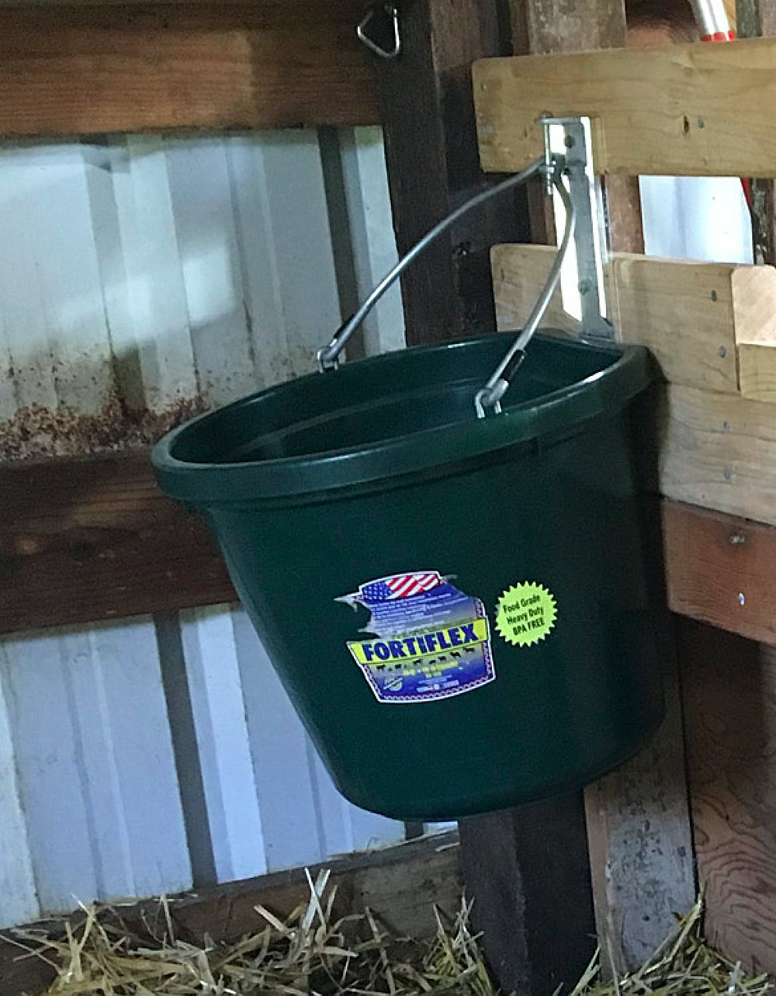
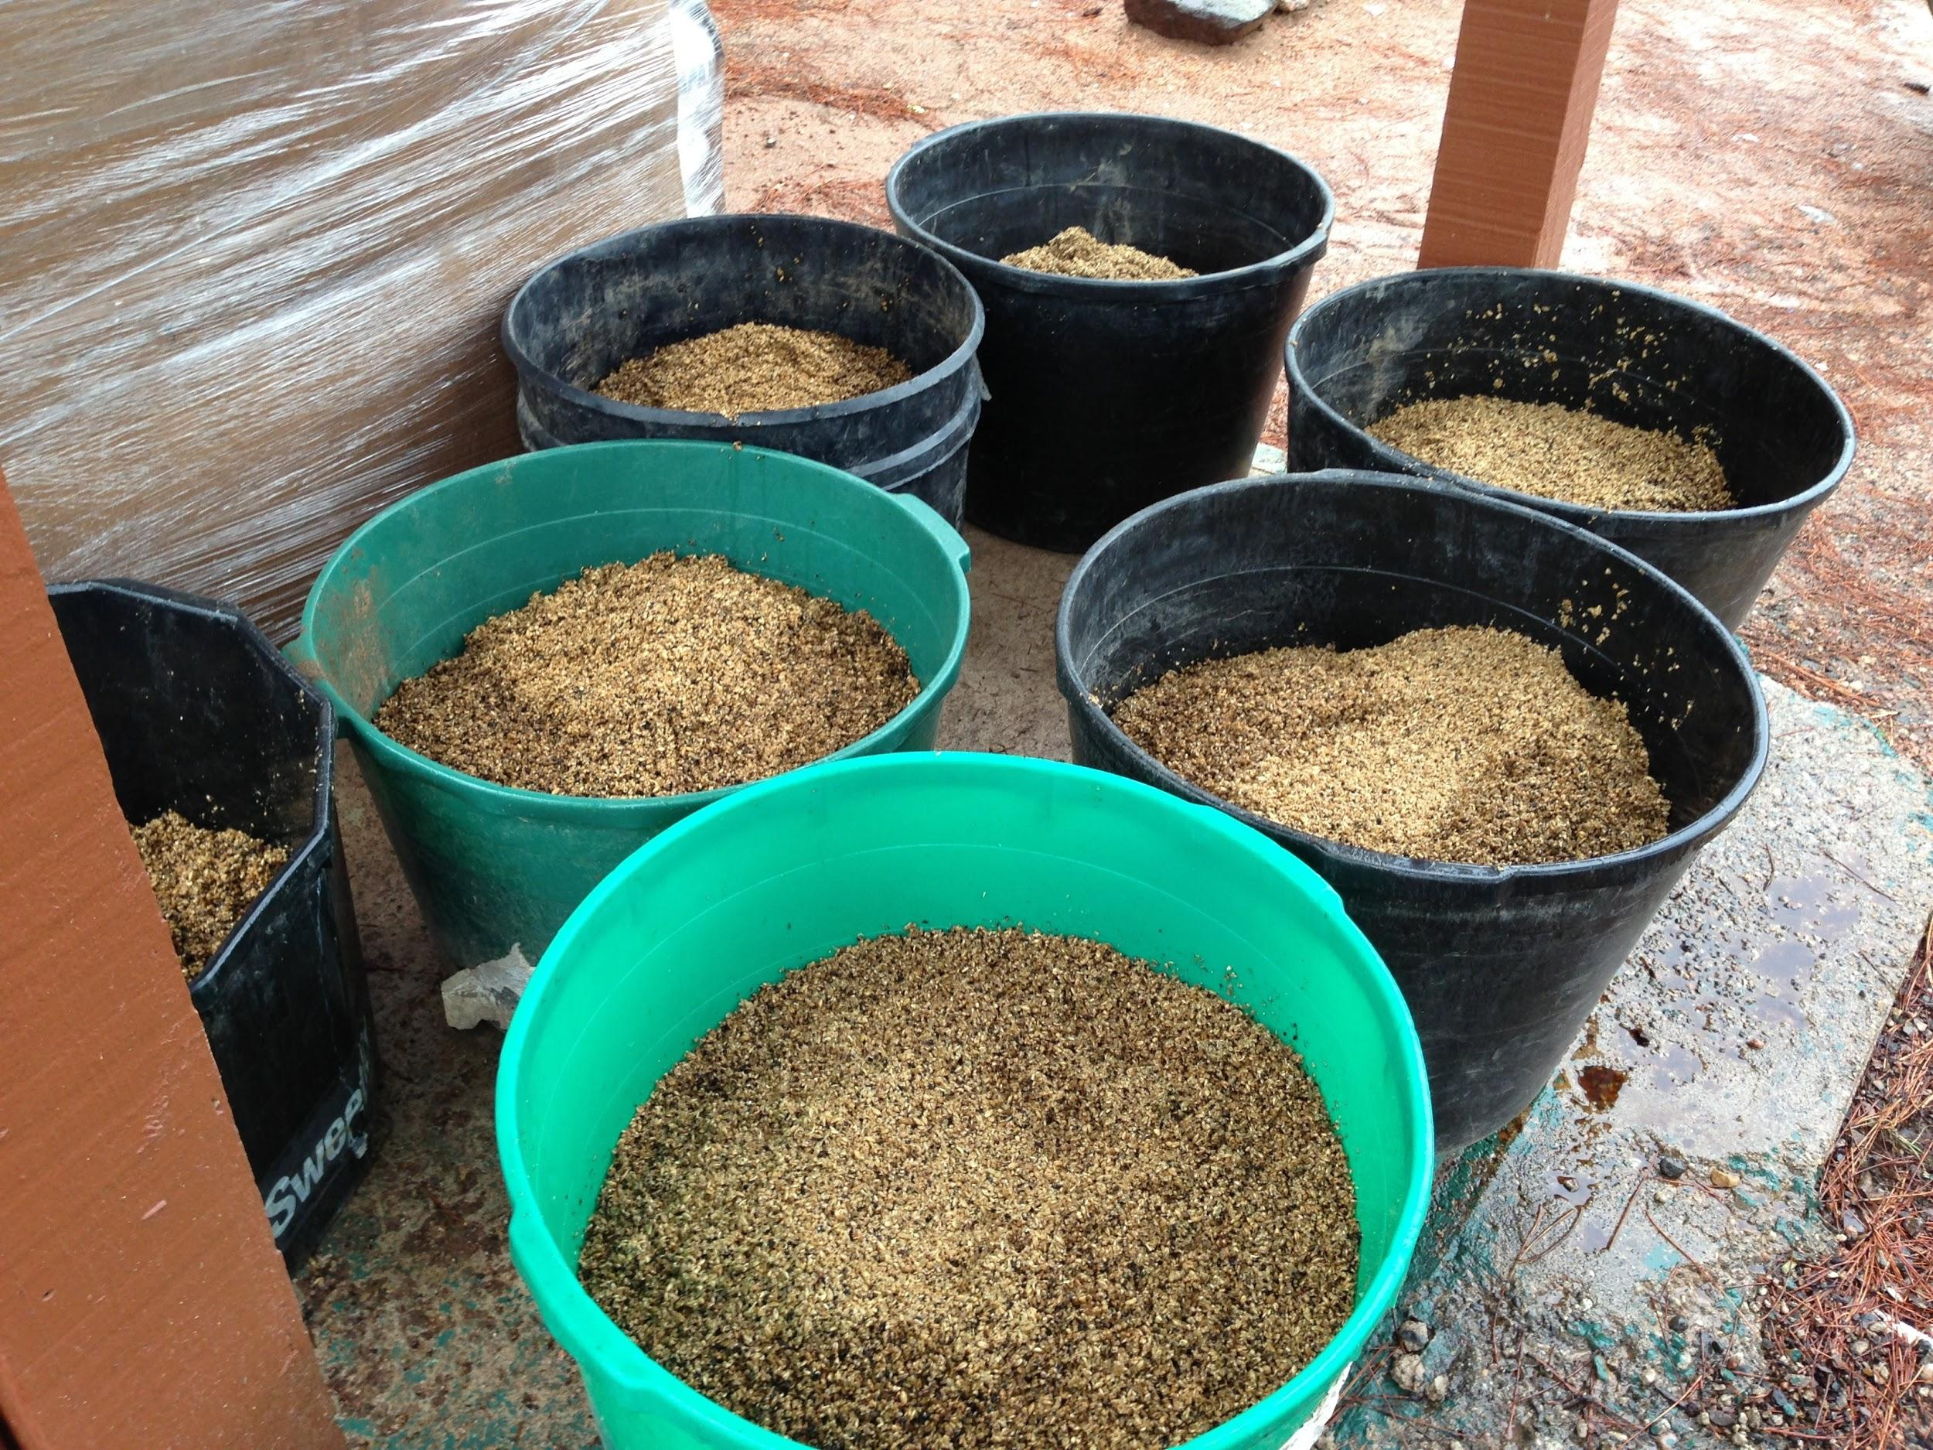
Expectations
All exhibitors must be available for barn duties throughout the Fair. It is the responsibility of the exhibitor to clean pens, and to water and feed their animals by 10:00am when the fair opens to the public. ALL ANIMALS MUST HAVE WATER AVAILABLE TO THEM AT ALL TIMES!
Keep the aisles and your pens clean. We offer a herdsmanship award; we are always watching!
Please remember to clean pens and aisles, tack areas, and to help others.
You are representing Carroll County 4-H. Pens for tack will be marked as such and are to be SHARED.

Slide 6
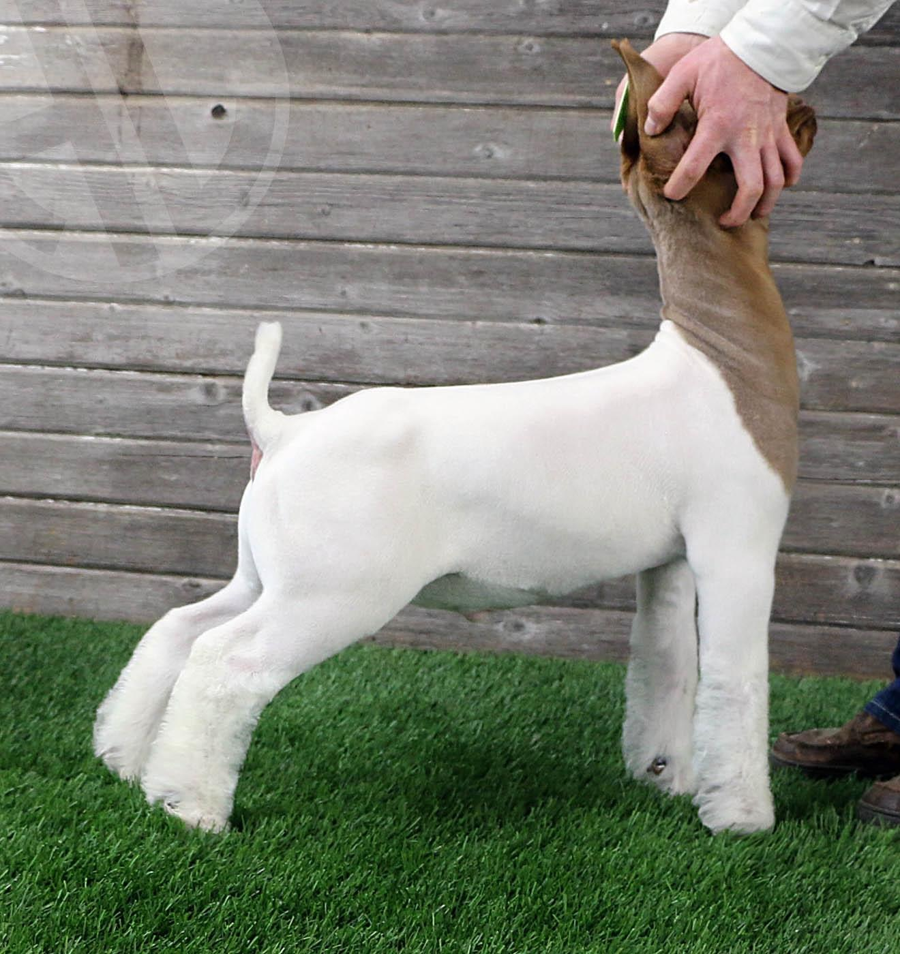
Market Goats
All market goats must be owned by May 1, 2023. Exhibitors may identify six animals – four may be exhibited.
All horns must be tipped. *Information
Scrapies ID tags are required.
Both wethers and does may be shown in the Market Goat classes. No intact males will be allowed in any market class.
Animals eligible for the show must weigh a minimum of 40 pounds with a Rate of Gain of .20 pounds per day and weigh 70 pounds or more to be eligible for the Livestock Sale.
All market goats must be weaned at least two weeks prior to the Fair.
All market goats must be slick shorn.
Market project animals will be mouth checked for the presence of milk teeth.
Any goats showing any signs of the first pair of permanent teeth may not be shown.

Slide 7
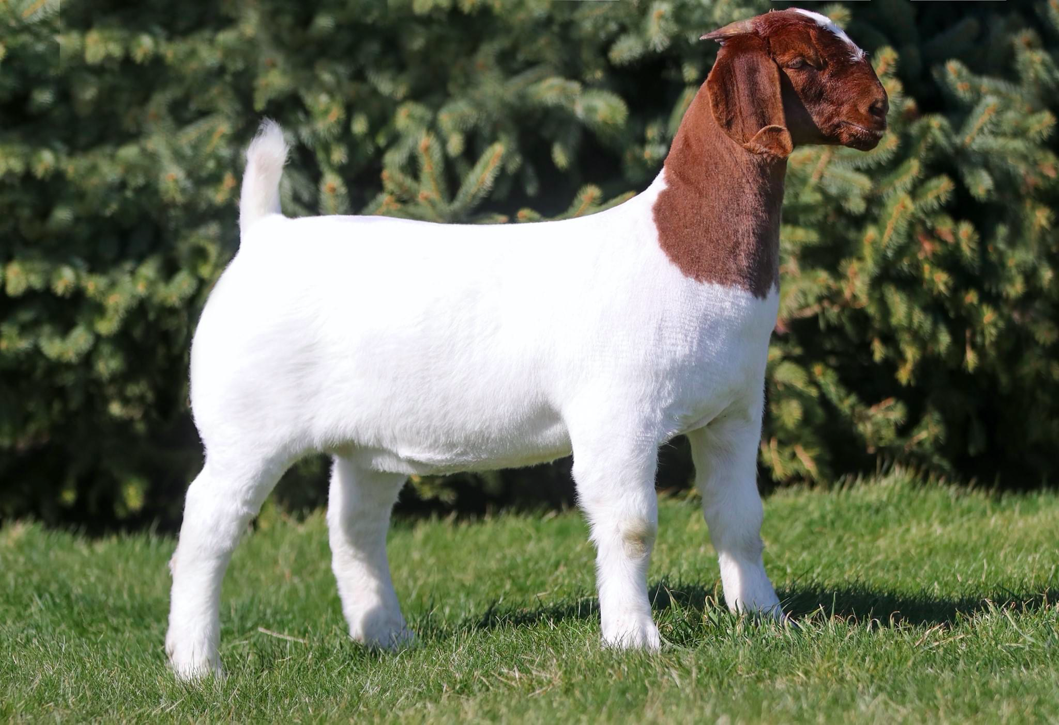
Breeding Goats
All breeding goats must be permanently identified by registration tattoo and have the original, official registration papers.
Breeding animal classes are for does and bucks. Animals shown in the breeding classes must be owned prior to June 30, 2023. Exhibitors showing kids born after June 30 must show proof of ownership of the dam.
Does may be shown in either the breeding or market goat classes, but not both.
Pens will be assigned and labeled with Exhibitor's names prior to the beginning of the Fair. Please use the same pens for the Breeding and Market Shows (if showing in both shows.)
You must present proper paperwork to one of the Superintendents before the show. You need to be in place by 8:30 am on Saturday.
If you are only showing in the breeding show, you must completely clean out your pen immediately following the show, and have it approved by one of the Superintendent before leaving the fairgrounds.

Slide 8
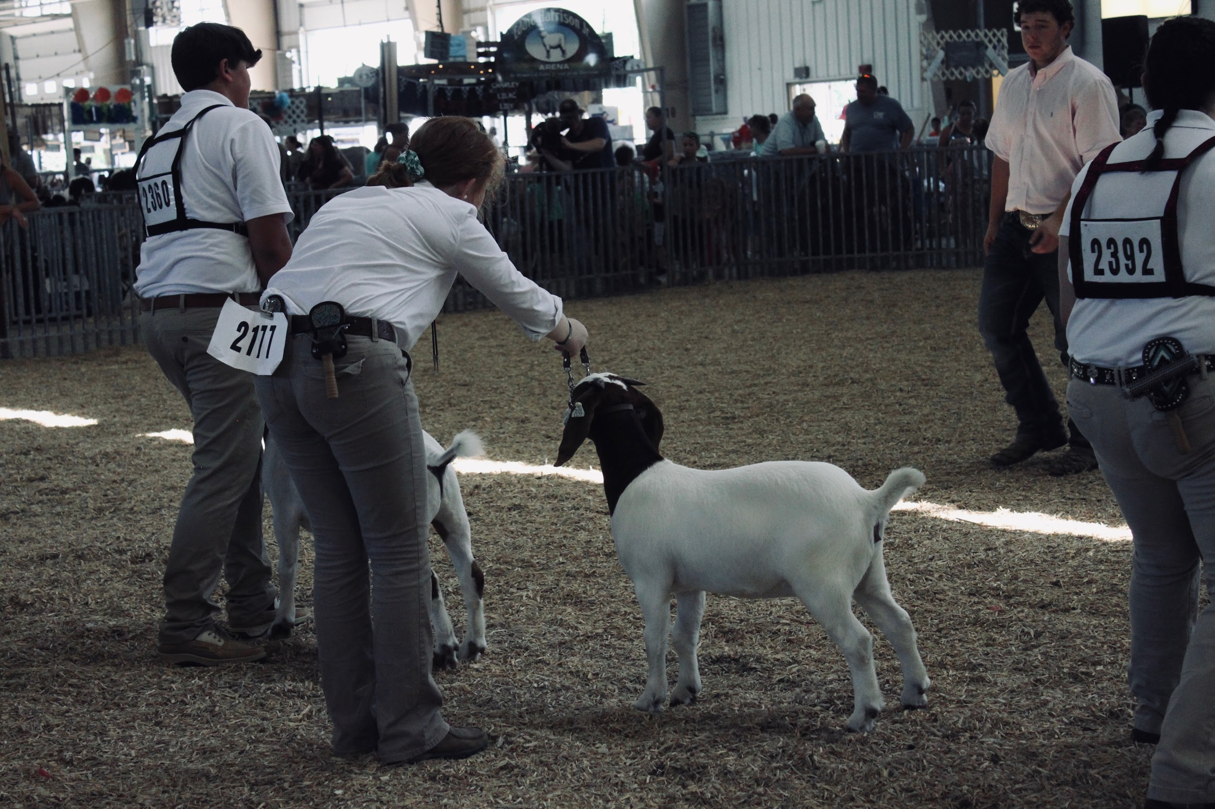
Fitting & Showing
If using a breeding doe, the doe must be UNDER THE AGE OF ONE YEAR OLD. No intact males will be allowed in any fitting and showing class.
Participation in fitting and showing is MANDATORY for all exhibitors showing a market goat, except for previous champions/champion challenge. Breeding animal may be used only if you do not have a market animal, however, due to space limitation it MUST BE approved by the superintendents. No intact males will be allowed in any fitting and showing class.
There is no novice class. Exhibitors will show within their 4-H age division. There are no clover classes.
During shows, goat’s feet must remain on the ground AT ALL TIMES.
Goats must be shown with a collar. No collars with prongs will be allowed. Leather goat show halters are acceptable.

Slide 9
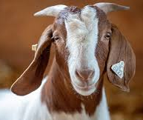
On-line Tutorials click on the links to learn about hoof care and Training
How to Trim Your Goat's Hooves
Tipping Goat Horns

Slide 10
On-line Tutorials click on the links to learn about hoof care and Training
Training Your Goat for the Show Ring

Slide 11
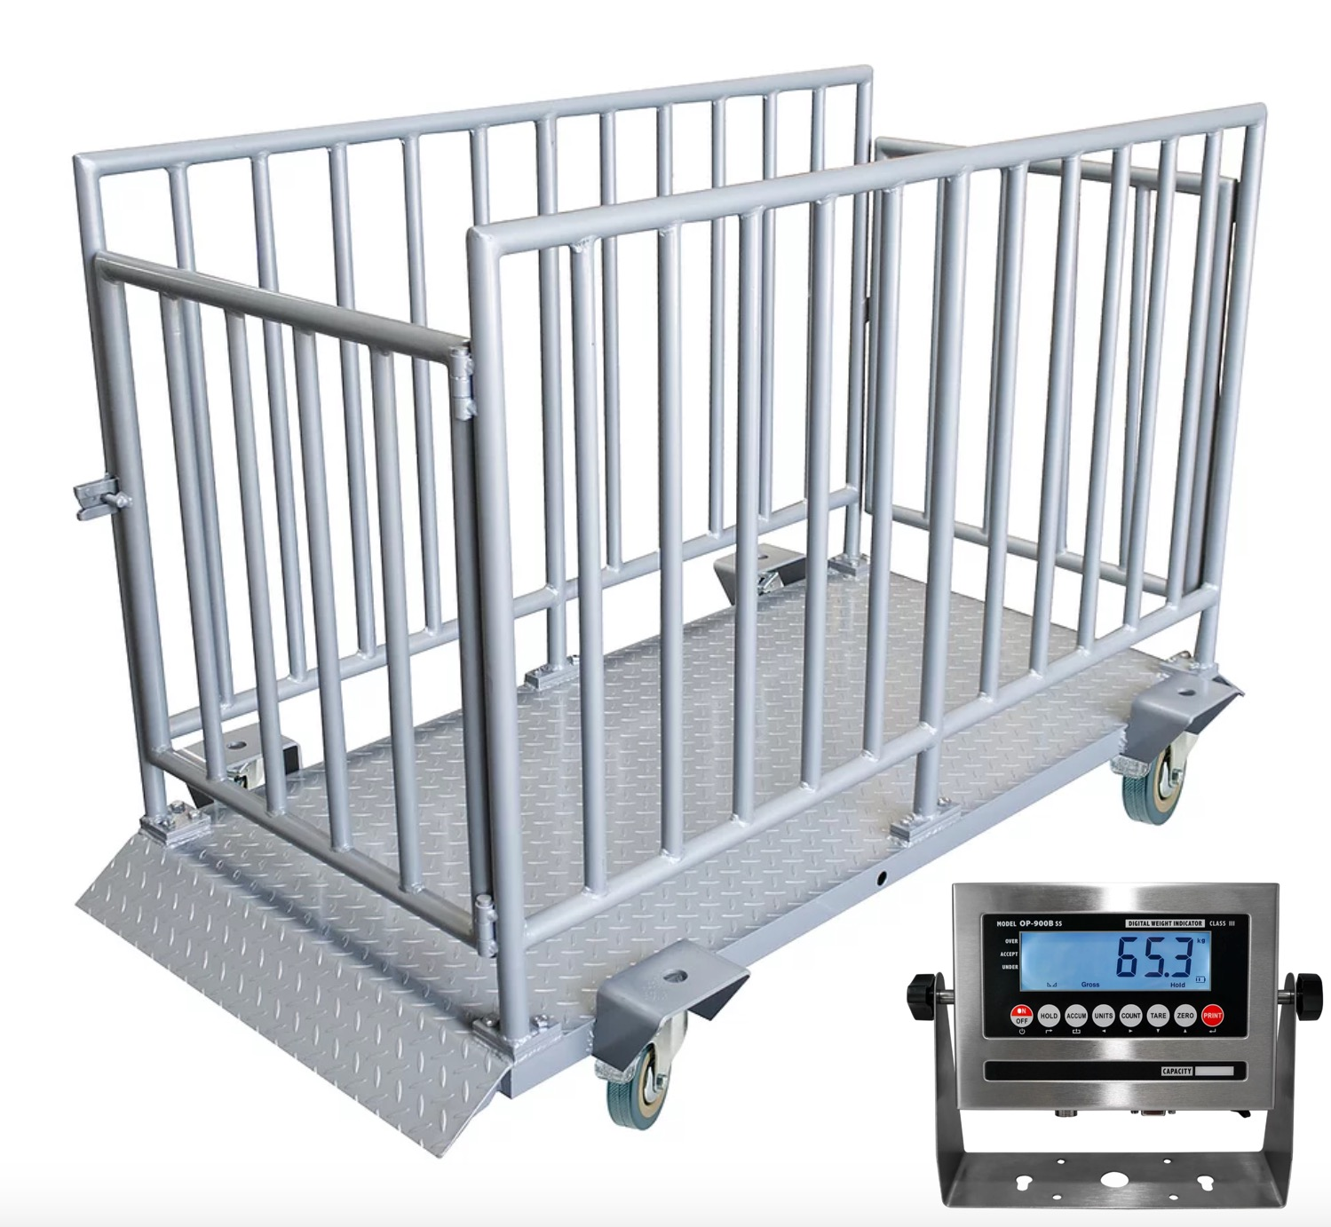
Weigh-in At the fair
To our knowledge, Market Goat exhibitors must be present at time of weigh-in on Sunday morning. Please walk your goats to the scale promptly. Scrapie Tags must be clean. We must be able to read them at the scale on Sunday morning for weigh-in and we must be able to read them for the show. Animals will be placed in weight classes following weigh-in at the Fair.

Slide 12
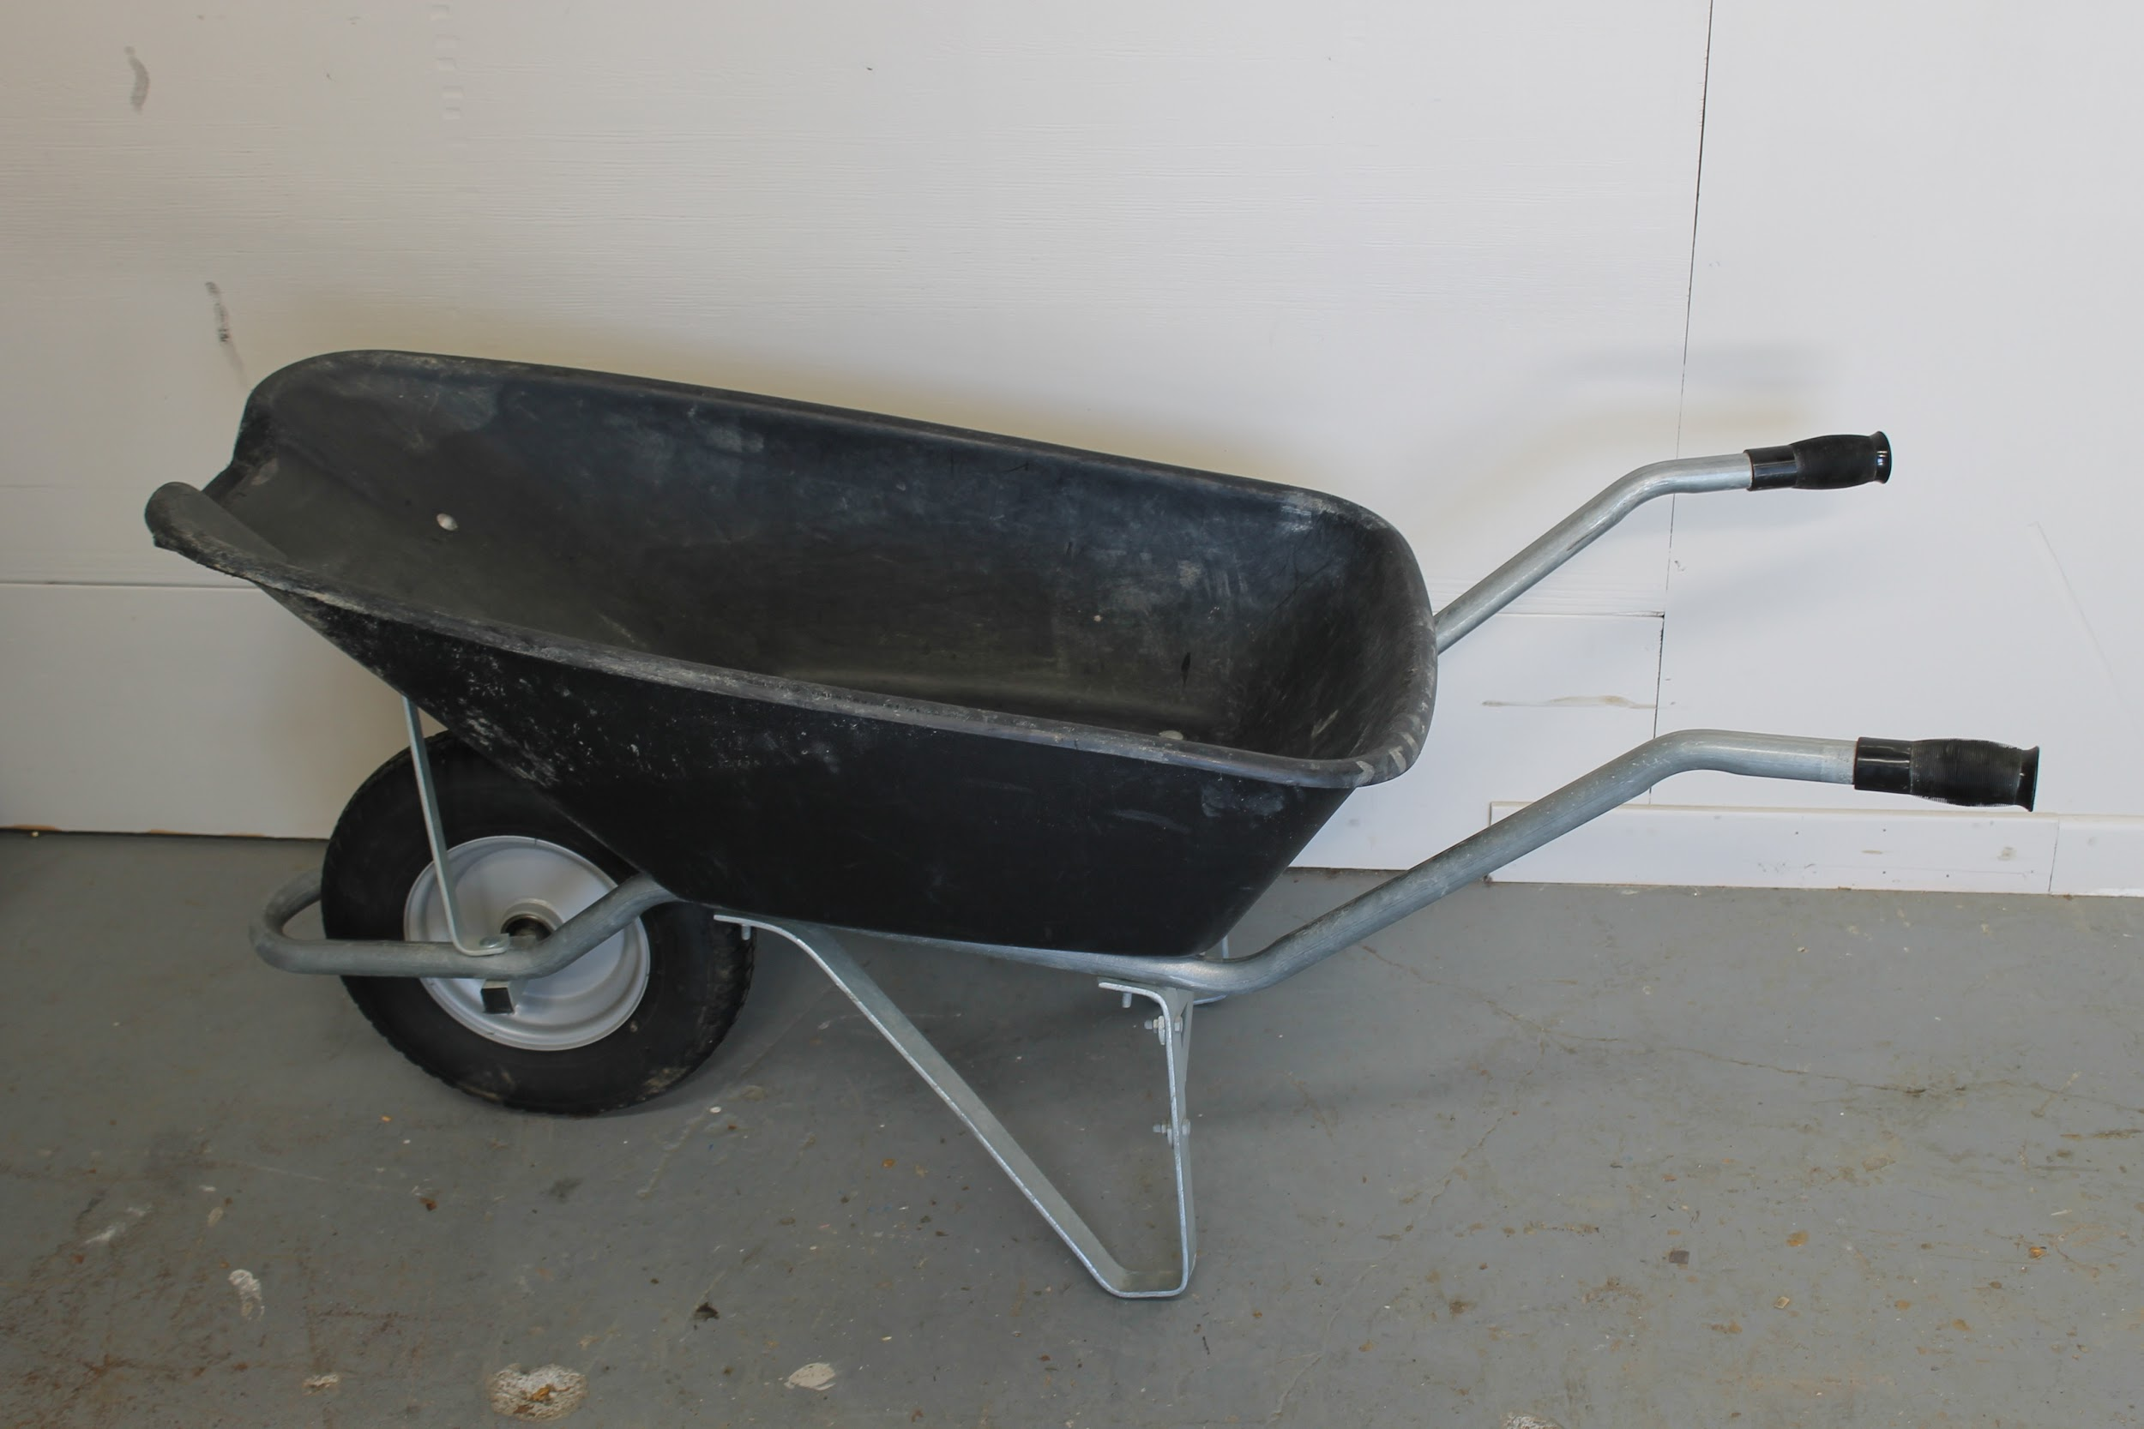
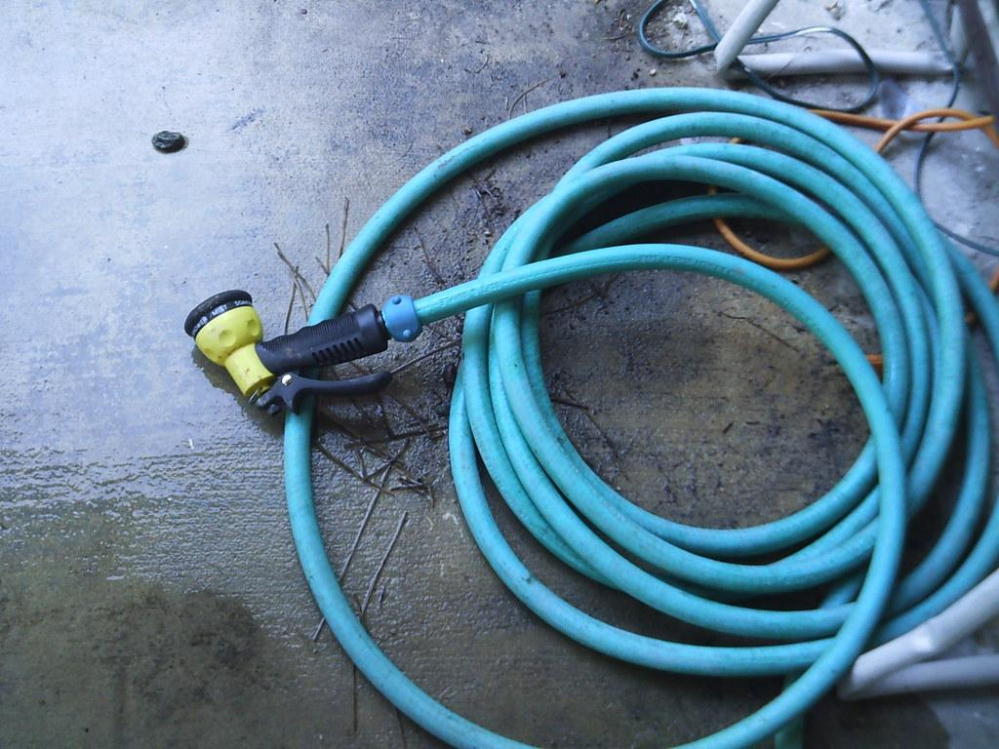
What to bring to fair
Goats must be shown with a collar. No collars with prongs will be allowed. Leather goat show halters are acceptable.
Water/Feed Buckets
Wheelbarrow
Feed
Soap/Shampoo
Hose

Slide 13

Exhibitor Community Communication
Buyer Letters
It is important that you communicate early to prospective buyers about your Market Goat Project. Take the time to write them a thoughtful letter and include all the options buyers have for their purchase. Many do not know that they can donate back to scholarship funds and the 4-H program. They do not have to take a goat home!
Thank you letters
All prizes will have an address label attached to them; make sure you write a thank you to prize donors. This is polite, respectful, and helps ensure future donations.

Slide 14

Release TIme
Your goats are released at the conclusion of the market show. You must take animals home that are not in the sale. They need to be removed from the fairgrounds – day and time to be announced. Make sure you do not remove the sale animal from the fairground. If you take the animal home, you cannot bring it back and it will be removed from the sale. Your pen must be cleaned and checked by one of the goat superintendents before you leave. Remember to take all your belongings home.
*This information is subject to change.

Slide 15

Livestock Sale Requirements
Market Goats must have a Rate of Gain of .2 pounds per day and weigh at least 70 pounds to be eligible for the Livestock Sale, with the exception of the 2023 fair season.
Exhibitors must:
1) have completed a project record sheet on last year's project,
2) sign and return the Commitment to Deliver Livestock Sale Animal to Processor form
3) participate in fitting and showing
3) first time 4-Hers, regardless of their age who are new to showing goats, and ALL new, incoming junior exhibitors must have attended a species workshop to be eligible to sell an animal in the livestock sale.
The judge will grade and select animals for the sale.

Slide 16
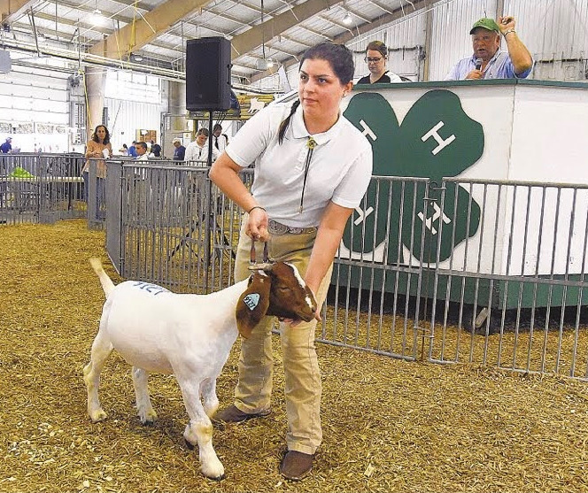
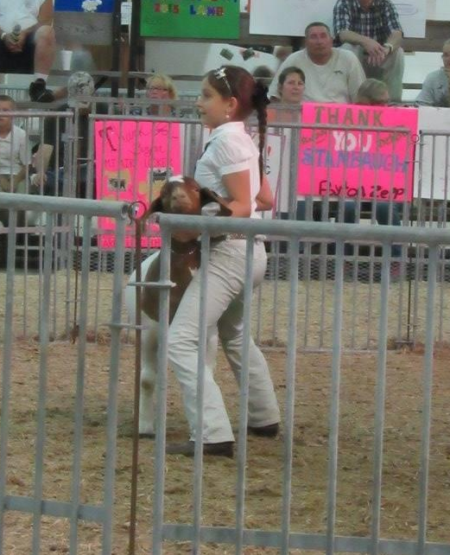
Livestock Sale
You must be at your pen in advance of the sale of your goat.
About half of the goats are sold toward the beginning of the livestock sale and the other half or so sell toward the middle of the sale.
We will come to get you at your pens and walk over together as a group, to line up for the sale.
You will need your goat's show collar.
You and your goat will have your picture taken with your buyer immediately after.

Slide 17
Paperwork Requirements
Animal Husbandry and Quality Assurance must be completed by July 2023 to be eligible for the 2023 fair. This must be complete by any new/novice showman and if you are moving into a new age division (junior to intermediate, intermediate to senior). AHQA can be found at: https://ahqa.umd.edu/
Carroll County 4-H/FFA Fair Entries are due by June 10, 2023, 11:59pm. Entries can be completed at www.carrollcountyfair.com

Slide 18
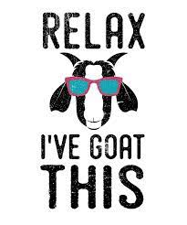

Take the quiz
Click here to take the quiz

