Slide 1


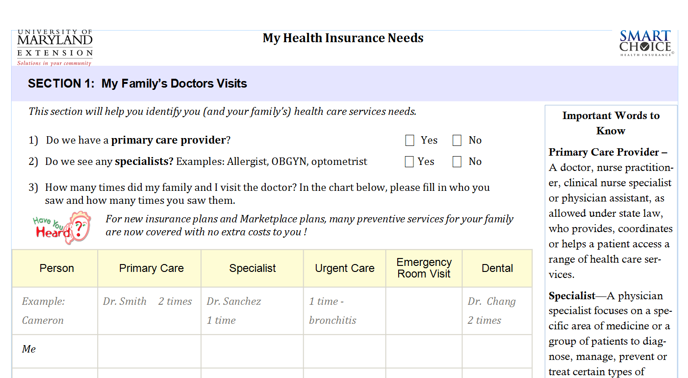
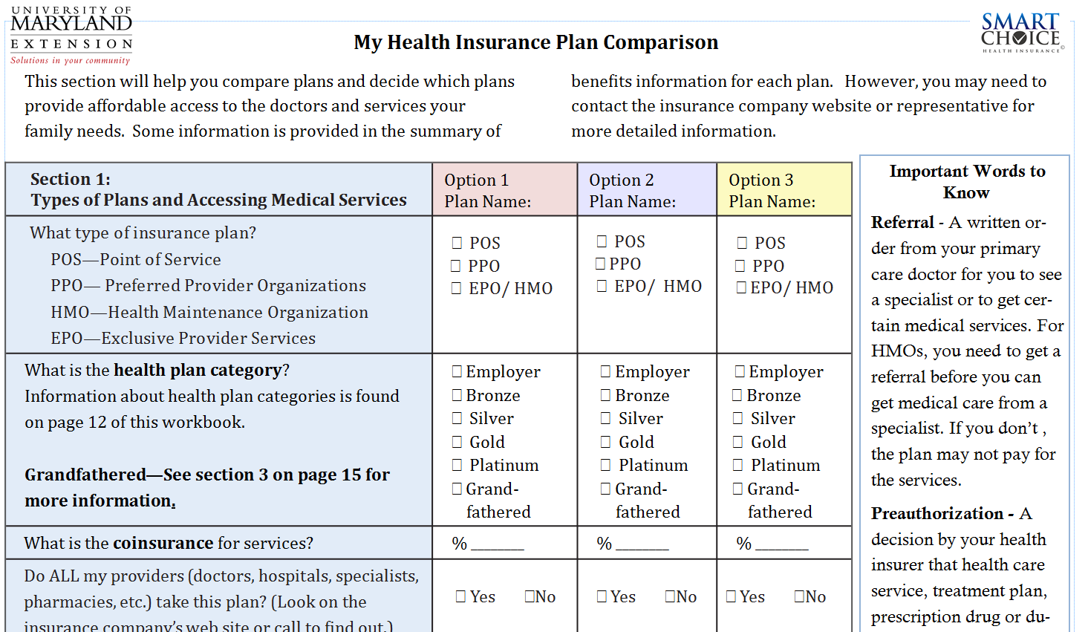
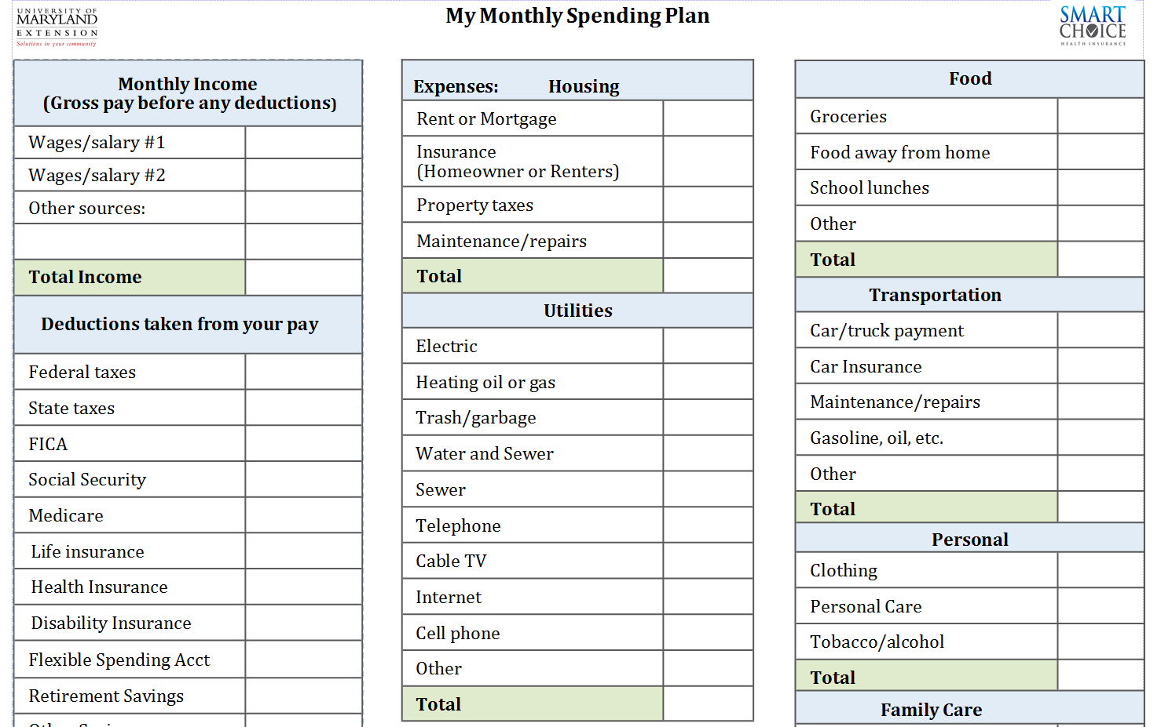
Smart Choice Health Insurance: A Decision Tool for Consumers Like You
Mia Russell, Bonnie Braun, Virginia Brown, Nicole Finkbeiner, Christine Garcia, Jinhee Kim, Lynn Little, Teresa McCoy, Megan O’Neill, Andrew Williams (University of Maryland Extension), Maria Pippidis (University of Delaware Cooperative Extension)
Multistate HILI Team Collaborators: Martie Gillen, Lyle Hansen, Elizabeth Kiss, Molly Vetter-Smith, Debra Wood
Funding from Smart Choice provided by the University of Maryland Extension and the College of Agriculture and Natural Resources
Research shows that consumers do not know what to consider when purchasing health insurance, such as their financial situation, health needs and available plans. The Patient Protection and Affordable Care Act of 2010 has attracted public attention to health insurance creating a teachable moment. Both consumers with health insurance and those newly-eligible are challenged to make health insurance purchases that meet their needs and resources. Extension can help consumers understand health insurance and improve their competency and confidence in making a smart health insurance decision.
The purpose of this curriculum is to guide consumers in making their health insurance selections. The education program discusses the importance of health insurance, explores ways in which consumers can access health insurance, reviews the information needed to make a health insurance decision and provides an opportunity for consumers to practice using the Smart Choice workbook to make a health insurance decision.
PROGRAM THEORY
BACKGROUND
PURPOSE
After completing the literature and program review, we determined the curriculum would focus on helping consumers obtain and understand the information they need to select health insurance plans and give them the critical thinking skills to make a smart choice. We found that consumers:
Want easy to obtain and easy to understand information.
Want to know plan costs, benefit specifics and flexibility (considerations of choosing doctors, specialists and coverage areas).
Do well when given an easy, yet effective tool to compare plans.
Deserve reliable information from a third party to limit coercion.
Are confused when offered too many choices.
Why? Consumers need to understand the many reasons why health insurance is important, to include peace of mind, financial protection, value-added health and wellness services and overall better health outcomes. We expressed importance from a risk reduction perspective. Overall, the curriculum focuses on the benefits of having health insurance.
What? Addressing needs and wants is an ever-essential skill for consumers. In this regard, the curriculum focuses on helping consumers to determine what their family needs are as well as the choices available. This discussion focused on frequency of doctors’ visits, types of doctors/specialists visited, medications, and current/pending medical conditions or changes.
How? Considering the consumers current spending plan/budget, the participants were asked to determine affordability.
Hypothesis Guiding
Smart Choice Health Insurance
Conclusion 3
Tool Guiding Curriculum and Tool Development
RC + IC & IC = SC
Reduce Confusion +
Increase Capability & Increase Confidence
=
Smart Choice
Why?
Why do I need health insurance?
What?
What do I need and want?
What are my choices?
How?
How much can I afford?
Why is it important?
How much will it cost?
Guiding Questions
GUIDING QUESTIONS
CONSUMER TOOLS
What?
What?
How?
The University of Maryland Extension programs are open to any person and will not discriminate against anyone because of race, age, sex, color, sexual orientation, physical or mental disability, religion, ancestry, national origin, marital status, genetic information, political affiliation, and gender identity or expression.

