Slide 1
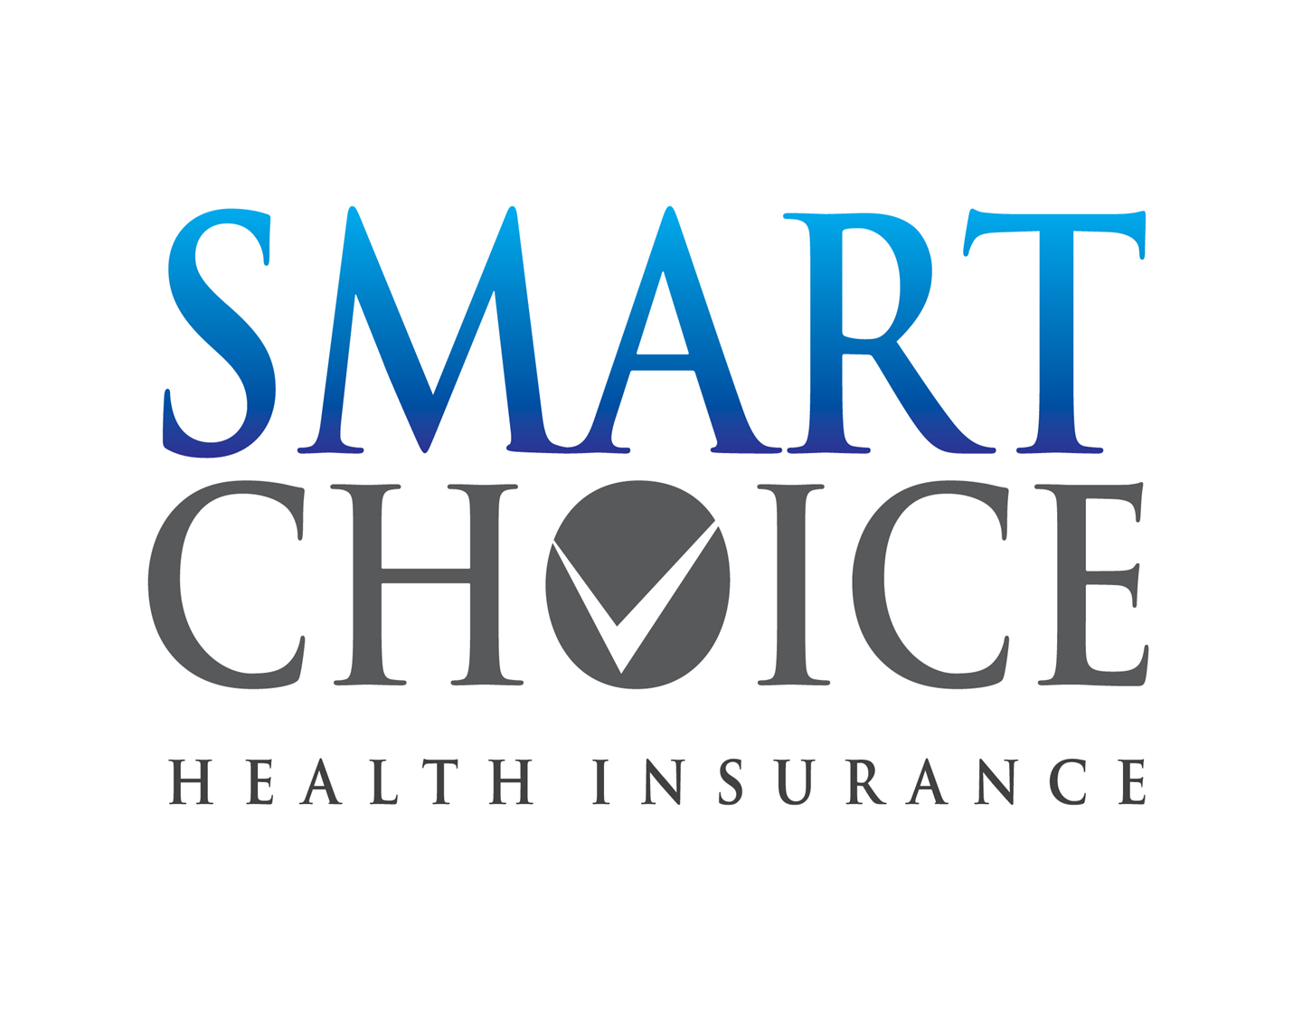

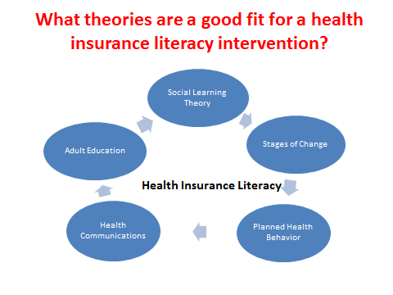

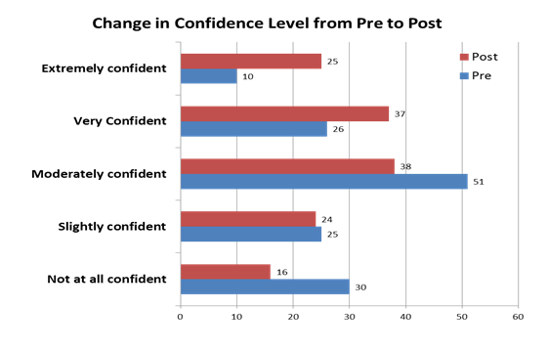

Smart Choice Health Insurance:
Pilot Test of the Health Insurance Literacy Initiative
Virginia Brown, Mia Russell, Jinhee Kim, Andrew Williams, Nicole Finkbeiner, Bonnie Braun, Teresa McCoy, Lynn Little, Christine Garcia, Maria Pippidis (UD)
INTRODUCTION
RESULTS
METHODS
The Affordable Care Act (ACA) was passed in 2010, expanding health insurance coverage to millions of Americans who may have previously never been insured. Additionally, the ACA called for changes to current health insurance plans, making it necessary for the currently-insured to understand how the changes will affect them.

Health insurance literacy is defined as:
The degree to which individuals have the knowledge, ability, and confidence to:
a) Find and evaluate information about
health plans;
b) Select the best plan for his or her family’s financial and health circumstances, and
Use the plan once enrolled.
However, research shows that almost all consumers are confused about their options. Those with low to moderate levels of financial, health and health insurance literacy will find the process of purchasing insurance challenging, which can lead to negative health consequences down the road.
The purpose of this study was to pilot the Smart Choice Health Insurance program. The program was tested and evaluated on the following three questions:
What are the strengths and weaknesses of program content materials?
2. What knowledge and skills do educators need to deliver the program?
3. What knowledge and skills do consumers need to make smart health insurance purchase decisions?
Theoretical Framework
Consumer Qualitative Findings
The Team
Consisted of an interdisciplinary team of health and finance educators, from the University of Maryland Extension and the University of Delaware Cooperative Extension.
Review of Current Programs
A literature review and program review of national resources was conducted. No complete health insurance literacy program was found. Therefore, the team decided to create a new one grounded both in theory and previous research.
Theoretical Framework
The following theories were used to inform the development the Smart Choice curriculum: social learning theory, stages of change, planned health behavior, health communications and adult education.
Testing
The program was tested in 7 states: Maryland, Kansas, Delaware, Georgia, Iowa, Missouri, and Texas. Both qualitative and quantitative data was collected from consumers and educators.
Programs lasted about 2 hours and were held at Extension offices, University(s) and other public facilities (libraries, etc.).
Participants
A total of 142 people participated in the research. 76% were female, 44% were 50-64 and 55% were white.
Data Collection and Analysis
Participant data was collected with both clicker technology and flip chart questions. Educator data was collected via Qualtrics and was both qualitative and quantitative.
Excel was used to analyze quantitative data. Trends and frequencies were run. Qualitative data was analyzed for trends and themes.
*The team would like to thank all the educators and states who assisted in the program pilot.
Consumers liked:
The consumer guide and its tools
Ability to engage in two-way interaction
Consumers wanted:
Written instructions for using the tools
More details on the ACA—the law, timelines
Additional information on cost, plans and options for care
Information on household spending plans and financial management
More time on the skill building portion of the program
Follow-up information related to health insurance
Quantitative Findings
Educator Qualitative Findings
Educators liked:
Curriculum being research-based
Interaction with consumers during workshop
Program content and worksheets
Opportunity to learn themselves
UME’s vision & leadership to create the curriculum
PURPOSE
Educators wanted:
Training to build capacity and confidence to deliver the curriculum
Centralized website with resources and educator follow-up tools
Customizations of skill-building portion with real-life examples
Revised workshop flow
Success metrics
Background on ACA
Toolkit
Moving Forward
Based on the findings, the Smart Choice team has and will:
Develop an Educator Toolkit and Educator Certification training for the Smart Choice Curriculum
Develop and provide case studies for the consumer workshop
Reorganize/revise program flow to provide consumers with more skill-building time
Provide evaluation metrics to measure program success
Develop supplemental pieces to allow customization of program for specific audiences
Continue research and evaluation to develop Smart Choice into an evidence based practice
University of Maryland Extension programs are open to all citizens without regard to race, color, gender, disability, religion, age, sexual orientation, marital or parental status, or national origin.

