Slide 1


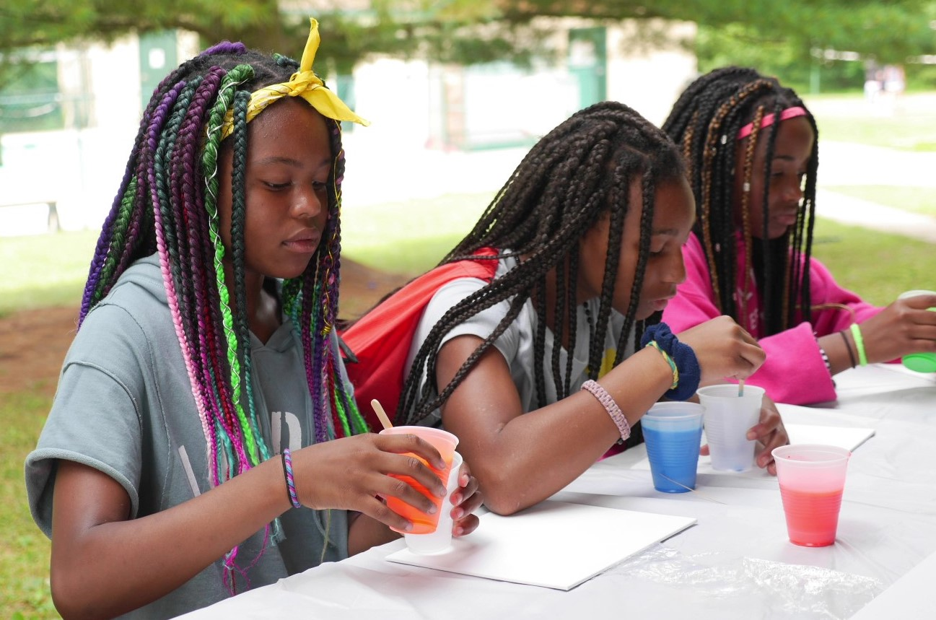

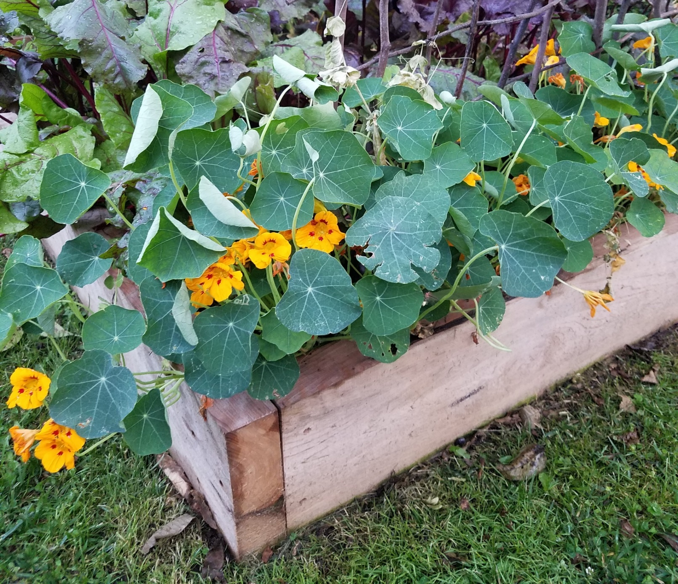
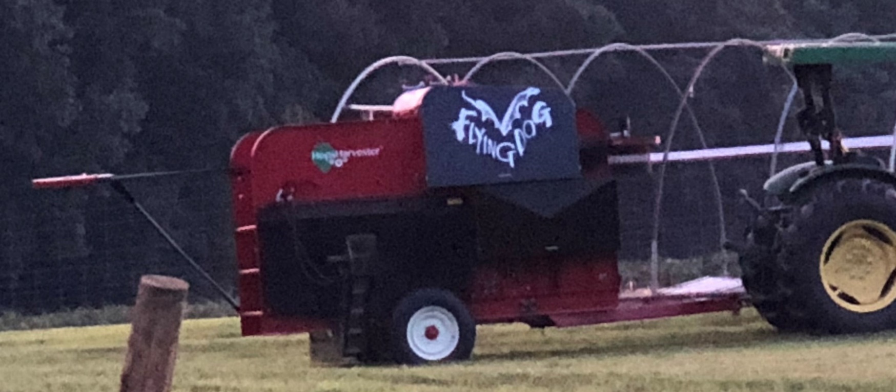
Carroll County - 2022

Slide 2
VISION: UME will be the preeminent Extension organization in the nation by providing the residents of Maryland with the highest quality of public service, distinguished educational programming, and cutting-edge research that addresses their needs.
MISSION: Enhancing the quality of life for people and communities by disseminating unbiased research-based educational information.
VALUES: Helping people; Diversity of programs and people; Intellectual freedom and creativity; Excellence in educational programs; Lifelong learning; Truth, ethical and professional conduct, and integrity.
IMPACT AREAS: Agriculture and Food Systems; Environment and Natural Resources: Healthy Living; Resilient Communities and Youth Development
Mission and Goals of UME

Slide 3
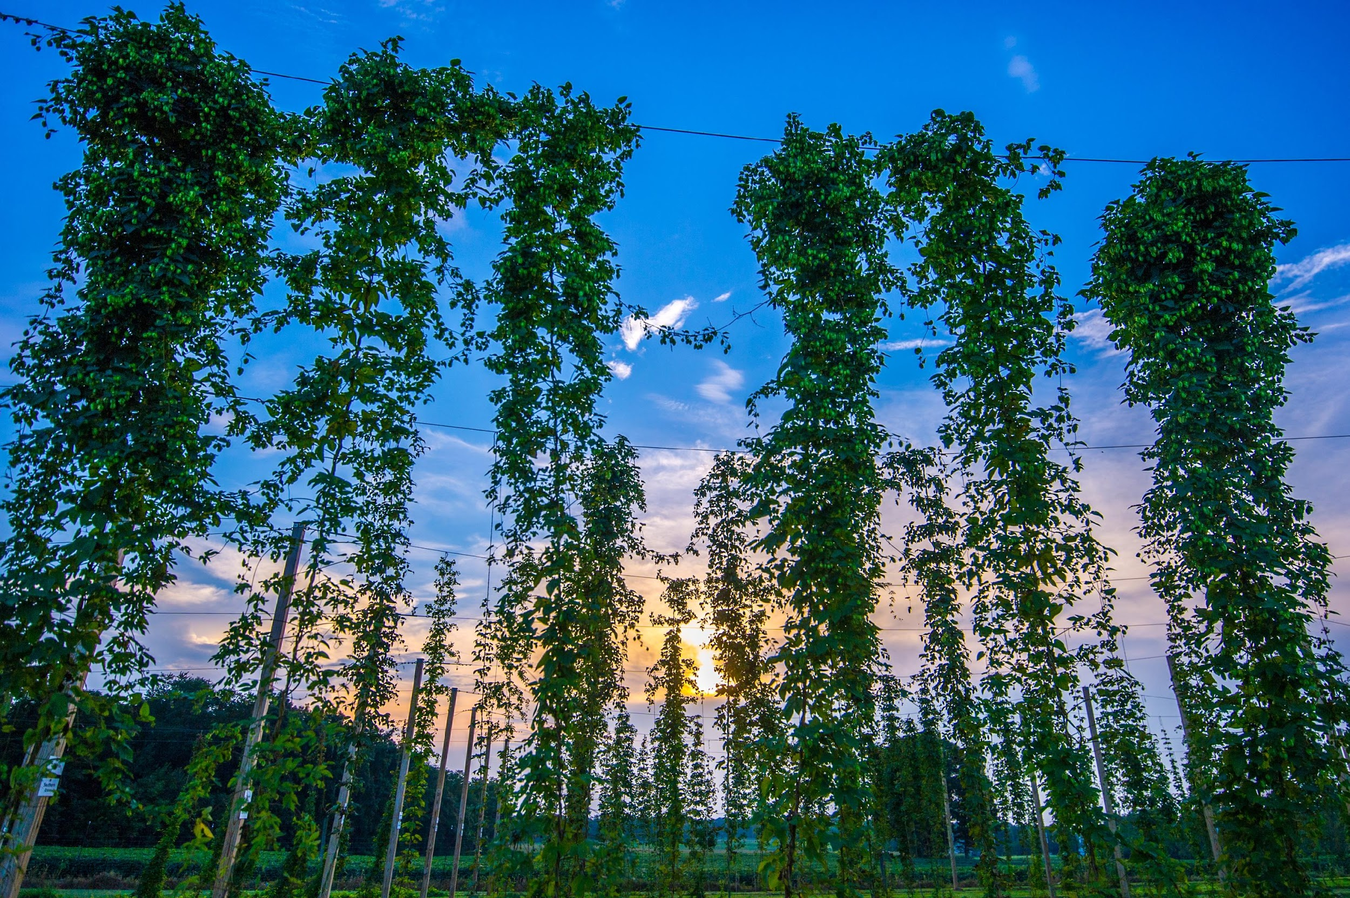
Researching alternative crops for the brewing and distilling industry with a focus on farm profitability with regard to the production of local ingredients.

Slide 4
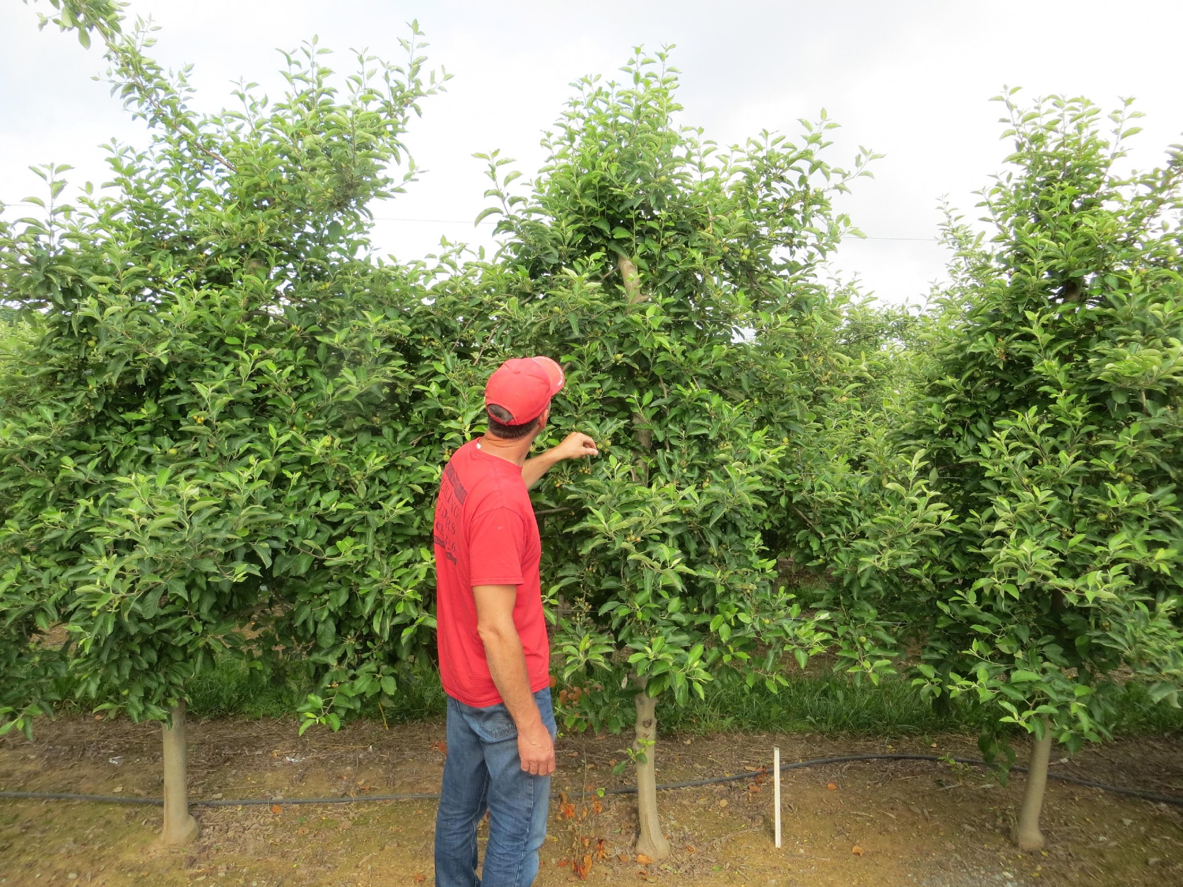
Consulted with 104 farming operations addressing specific needs of the producer for their operation

Slide 5
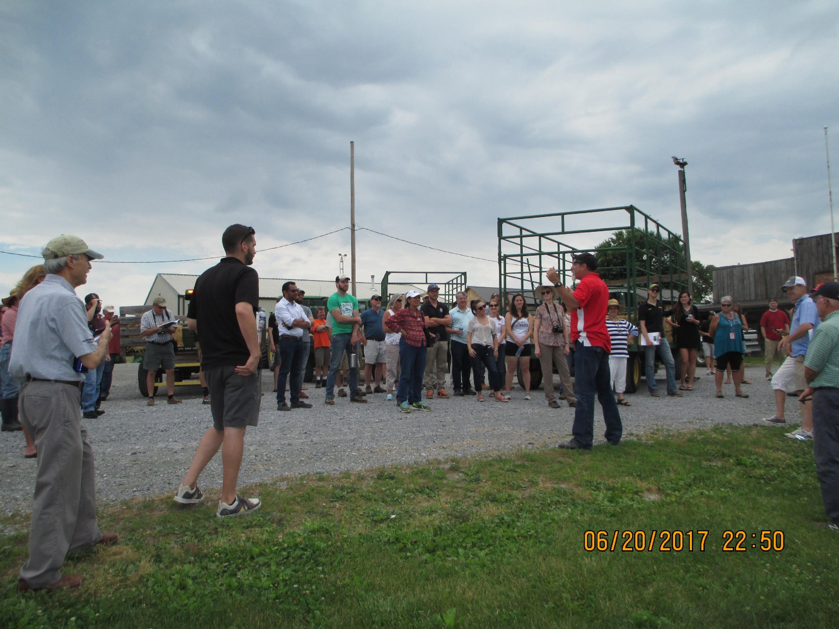
Facilitated the completion for new or renewal of 212 Nutrient Management and Pesticide certifications

Slide 6
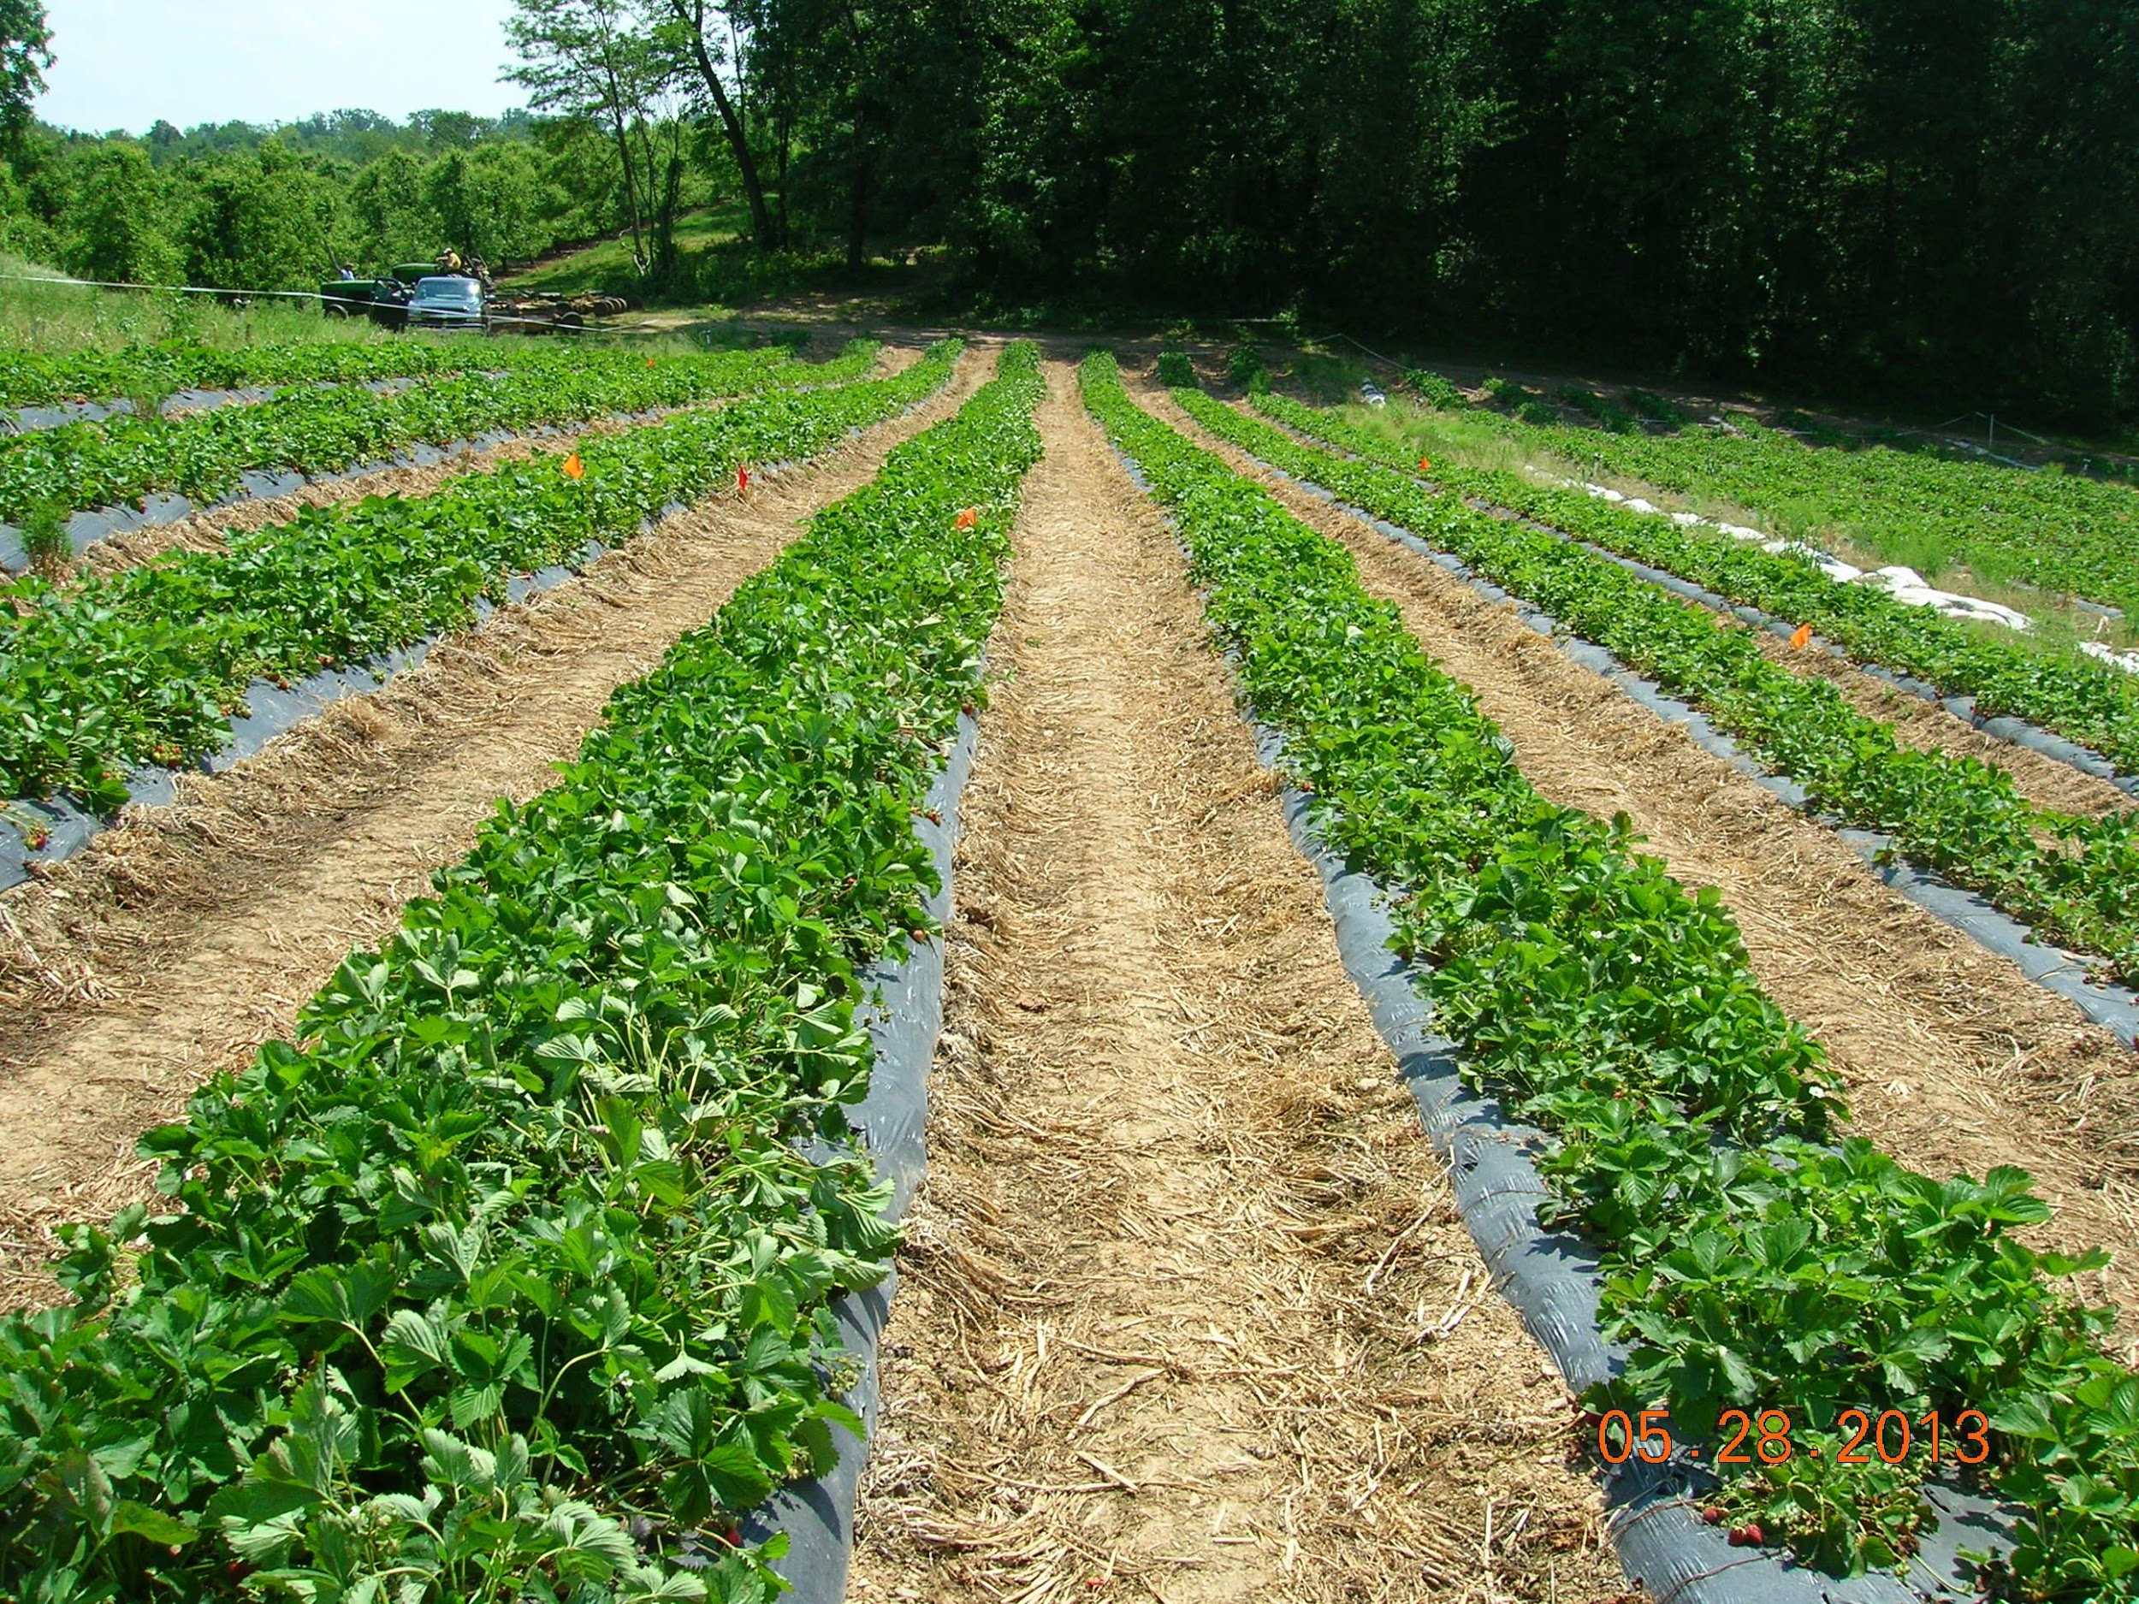
Wrote Nutrient Management plans for 10,409 acres to assist farmers in using nutrients more efficiently

Slide 7
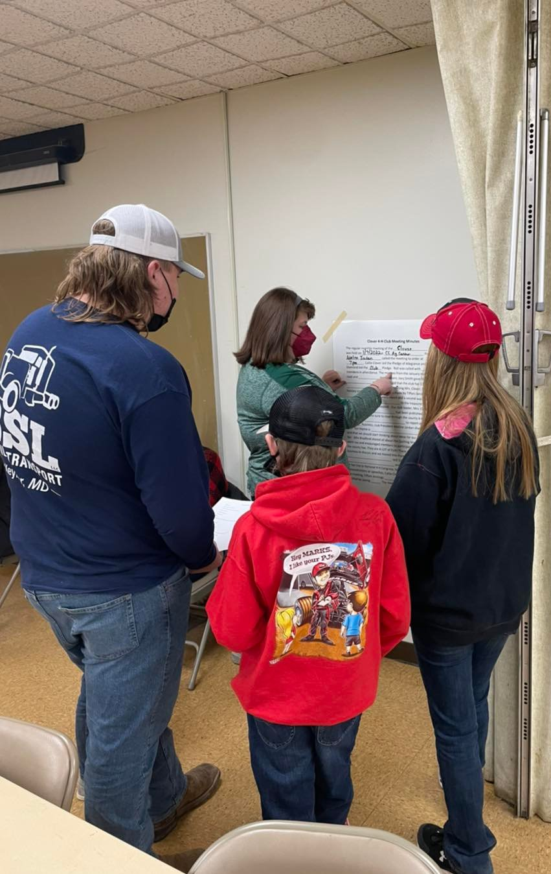
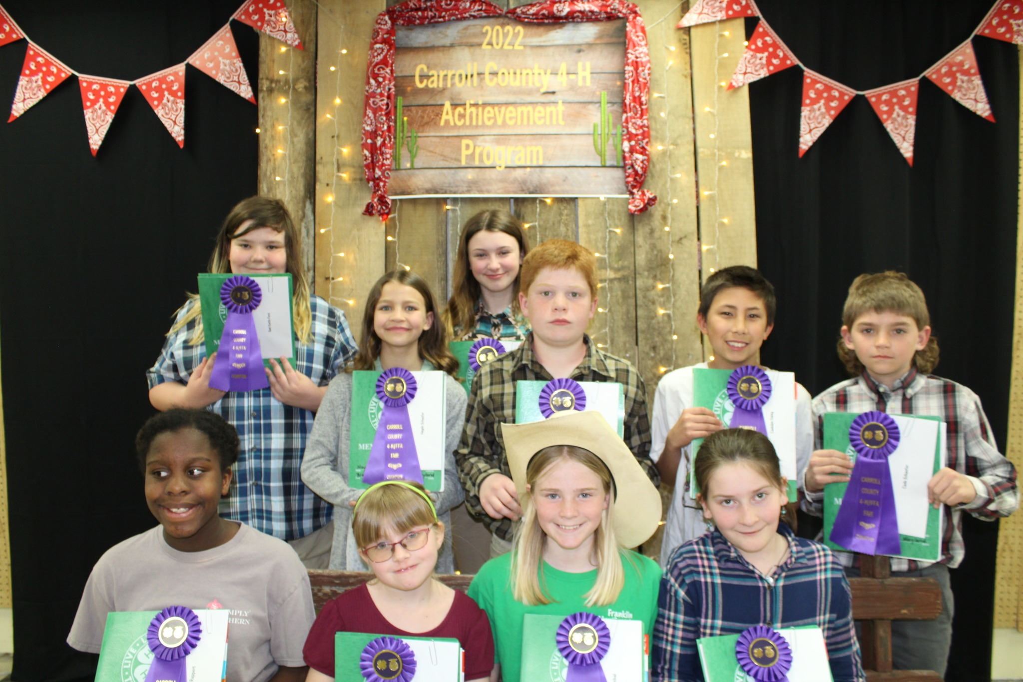
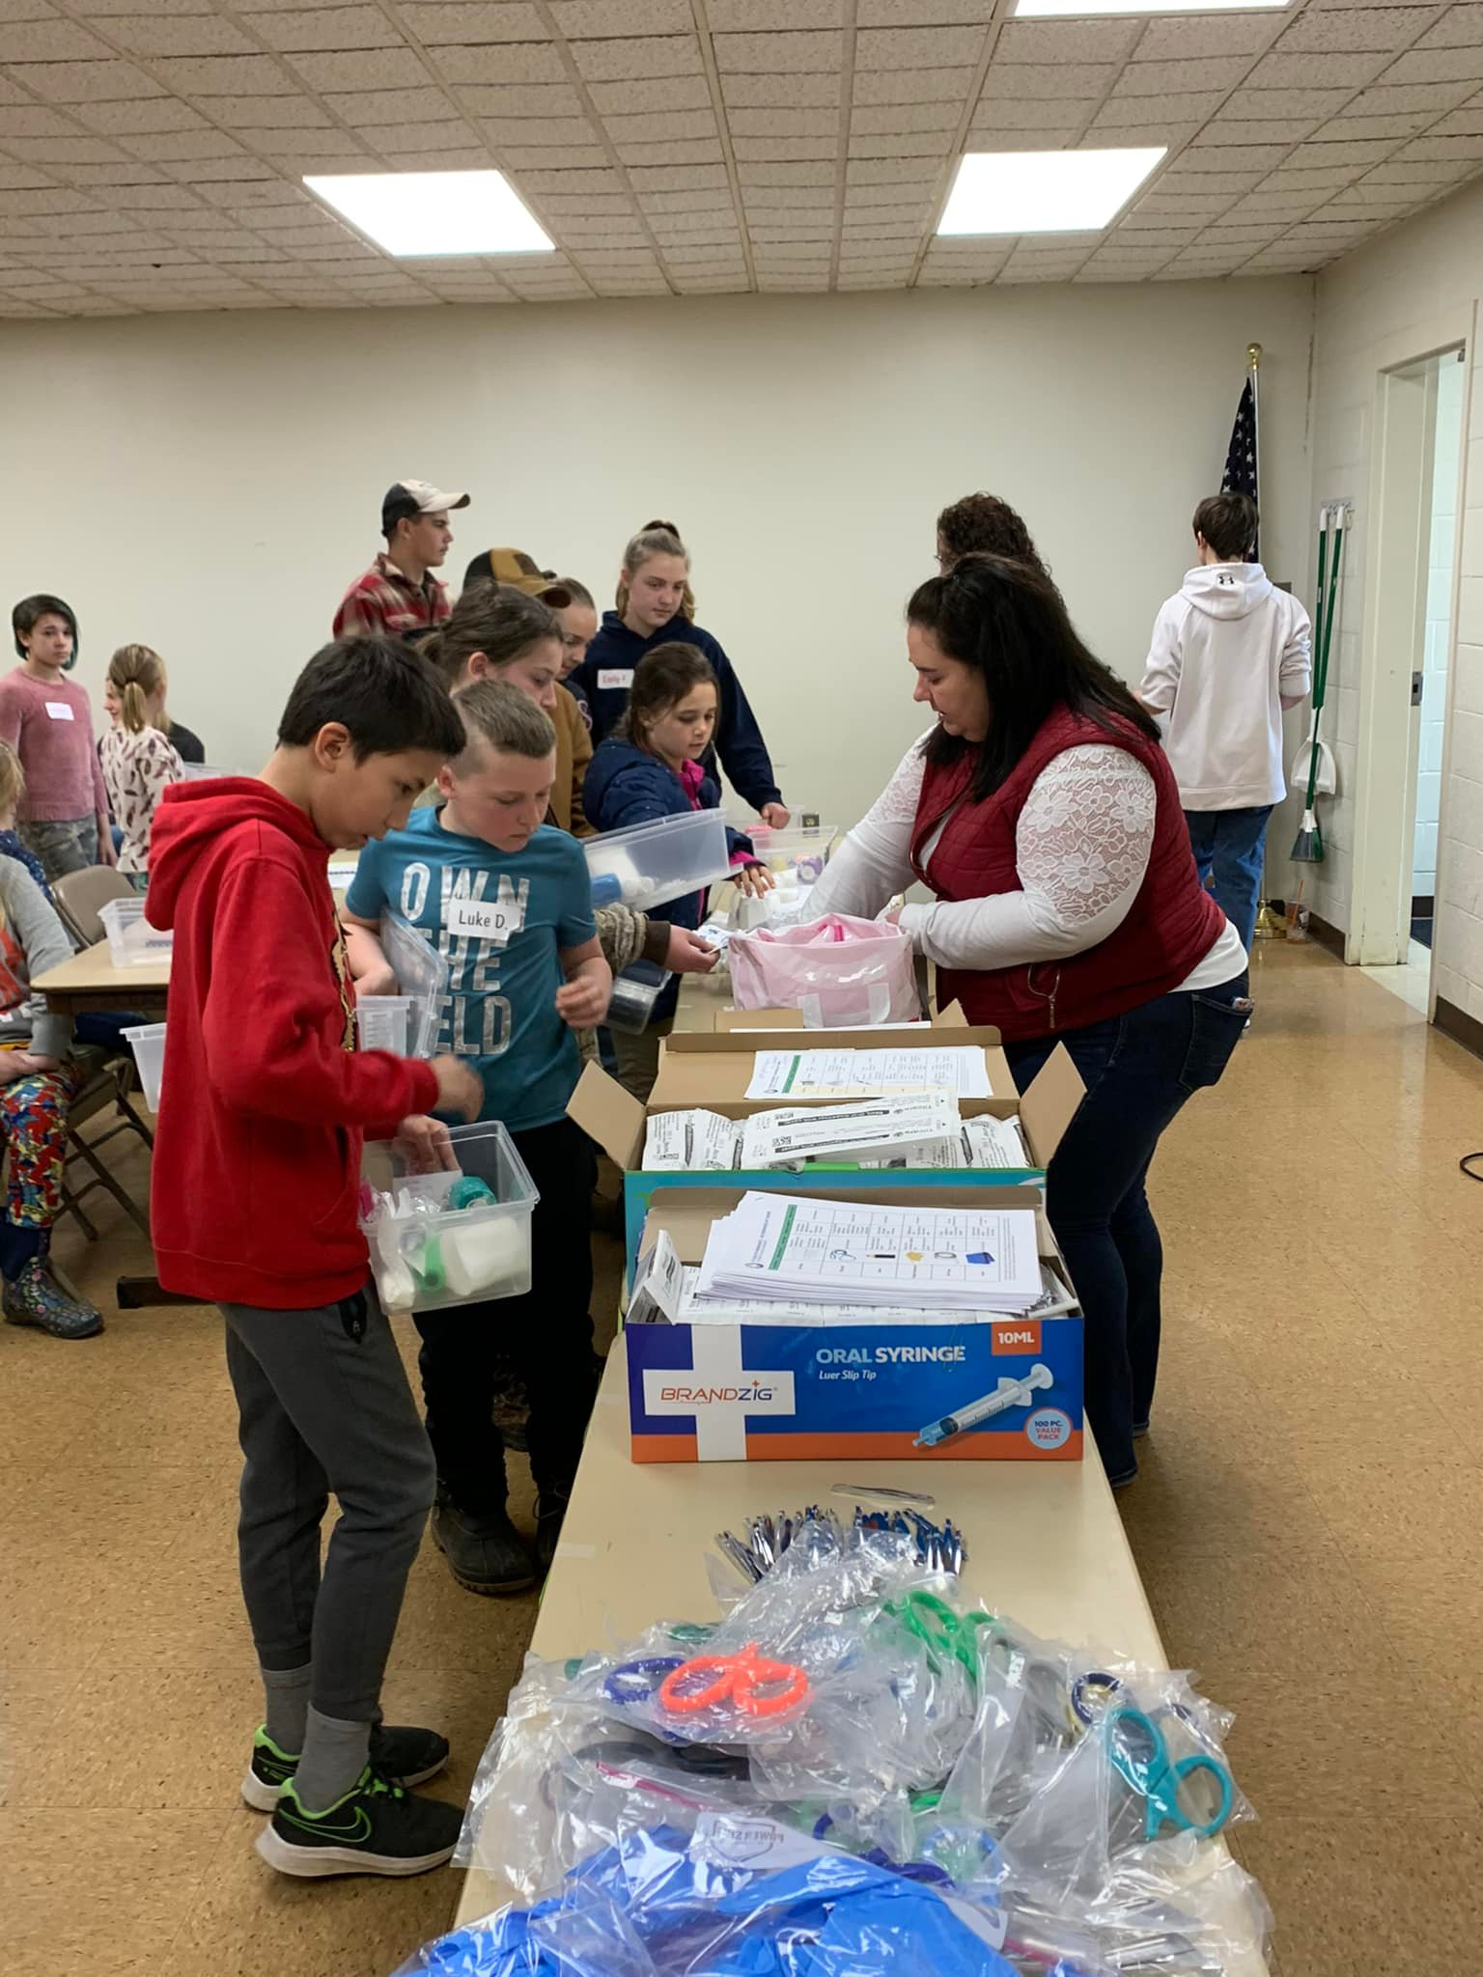
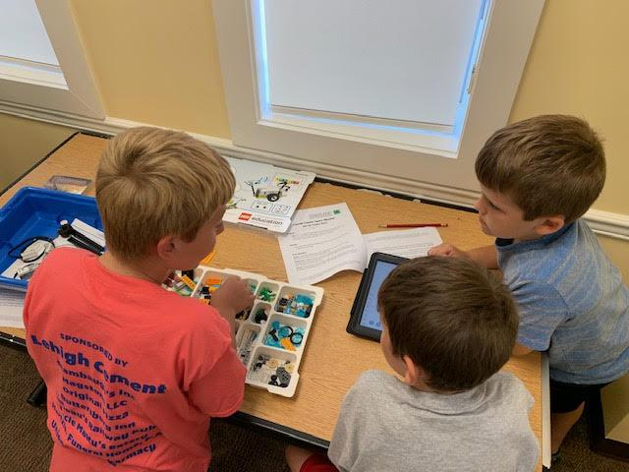
Largest community club program in Maryland with 777 youth/ 320 volunteers donated ~19,200 hrs. valued at $575,040

Slide 8
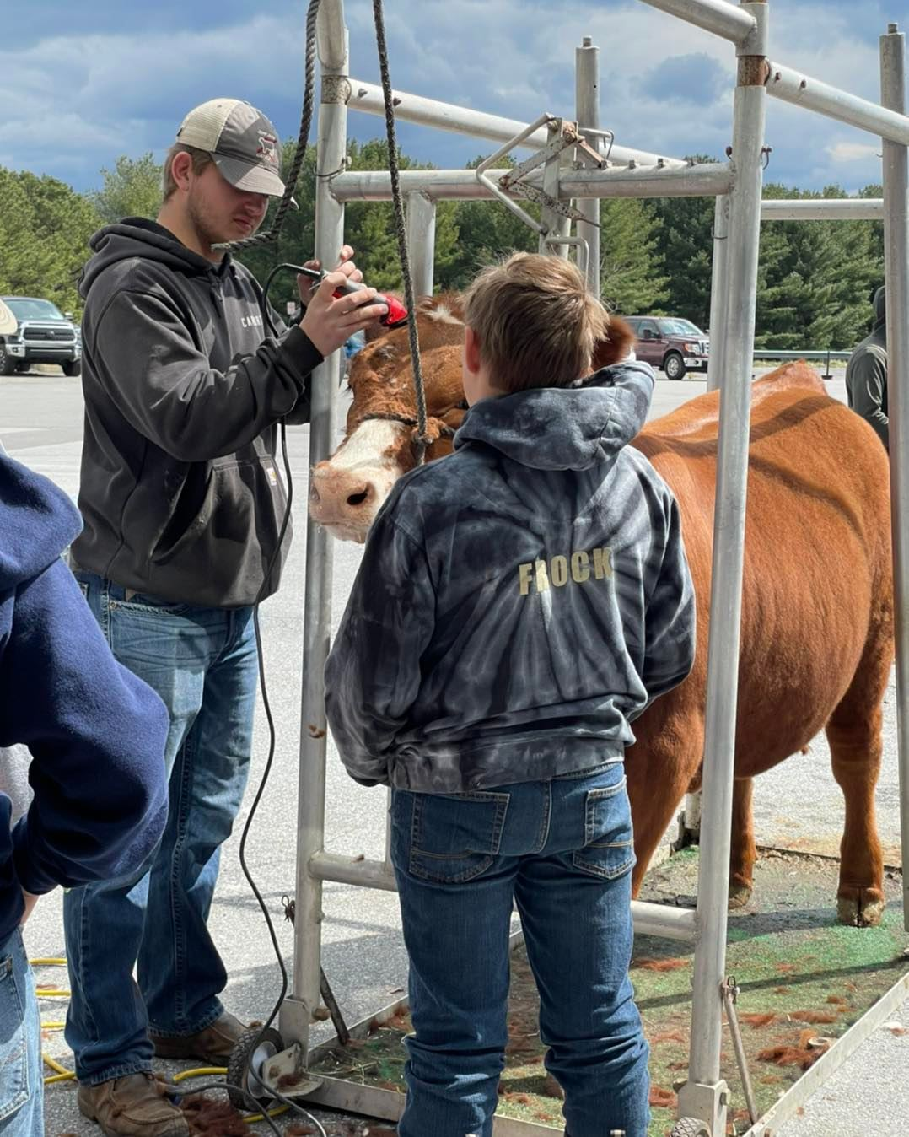
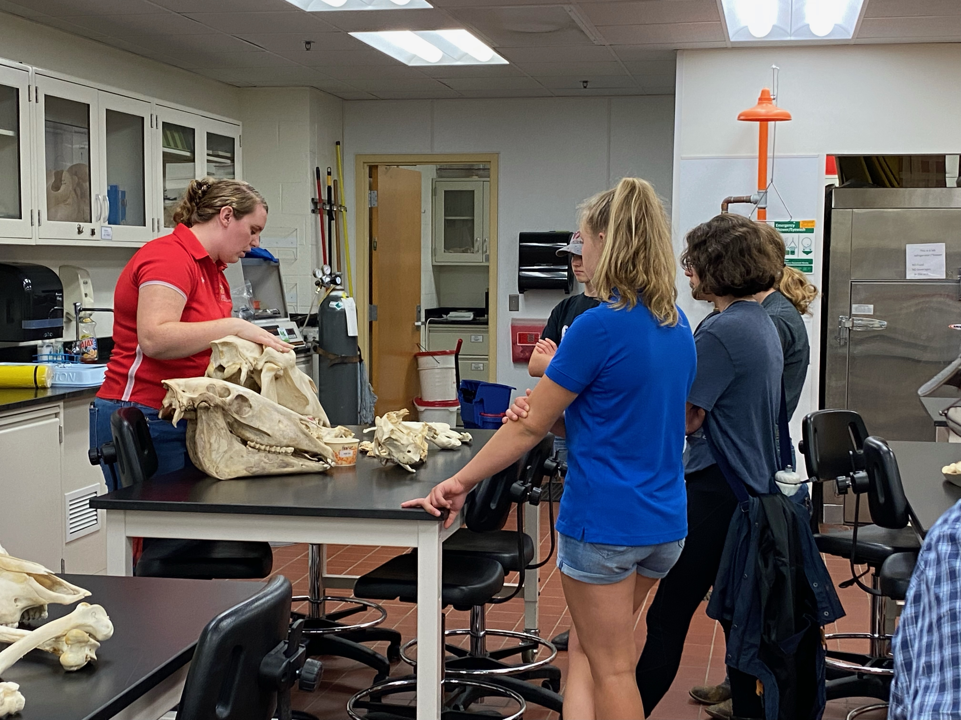
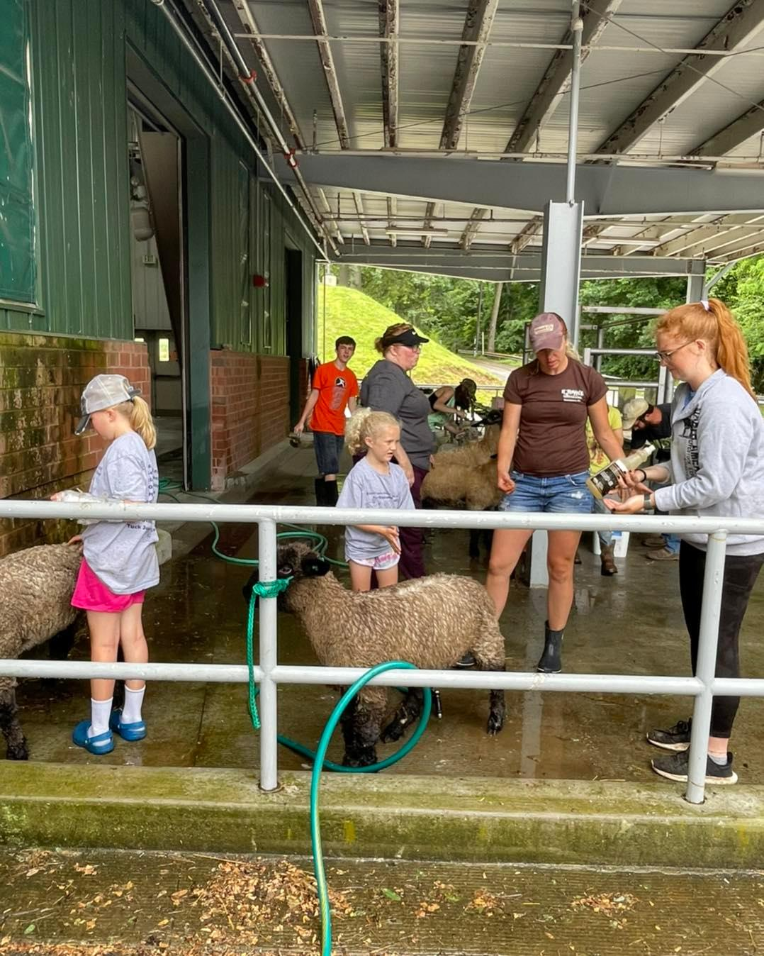
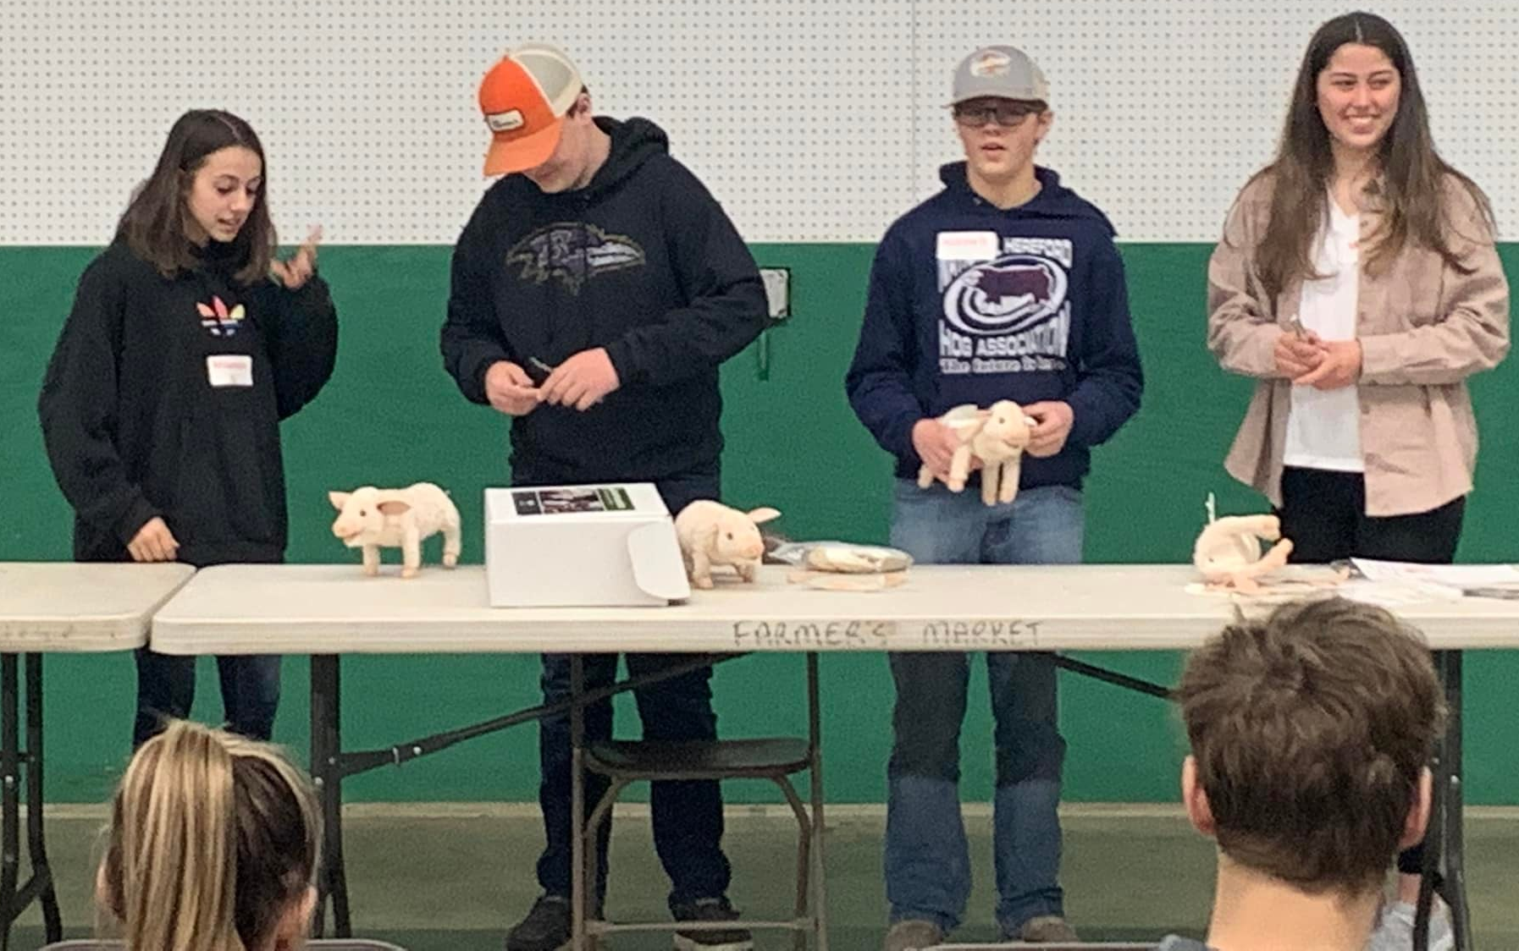
Conducted 15 Animal Science programs reaching 1,507 youth and adults

Slide 9
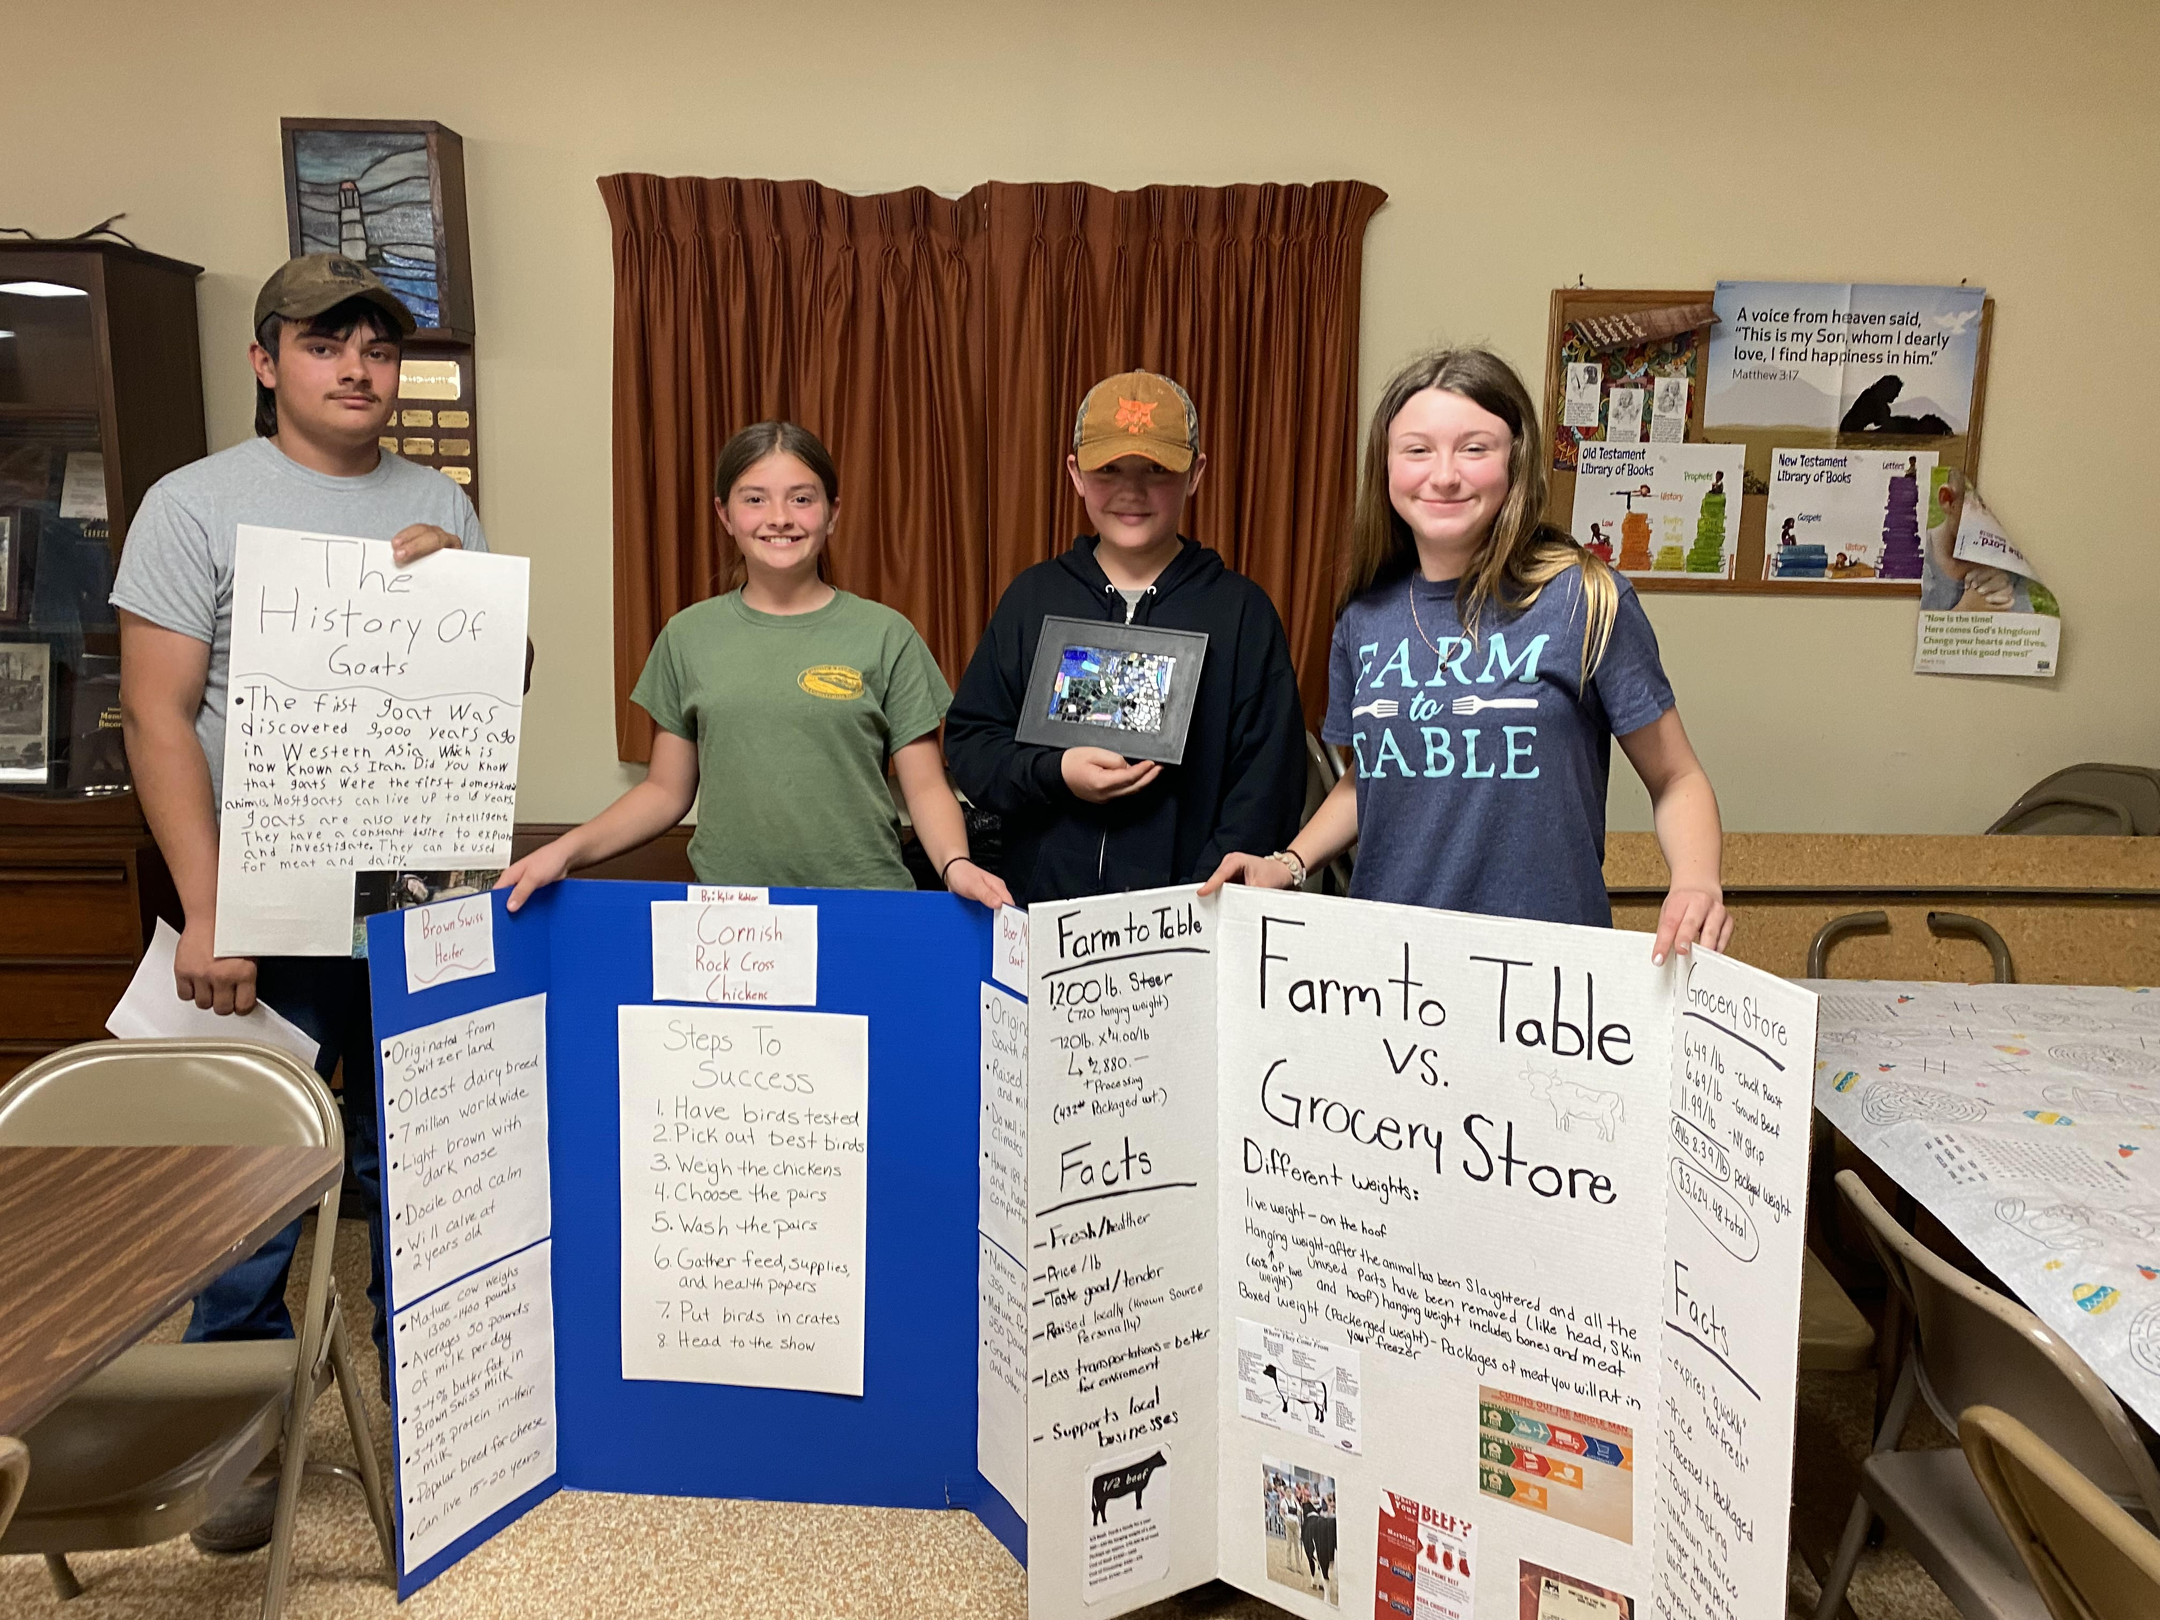
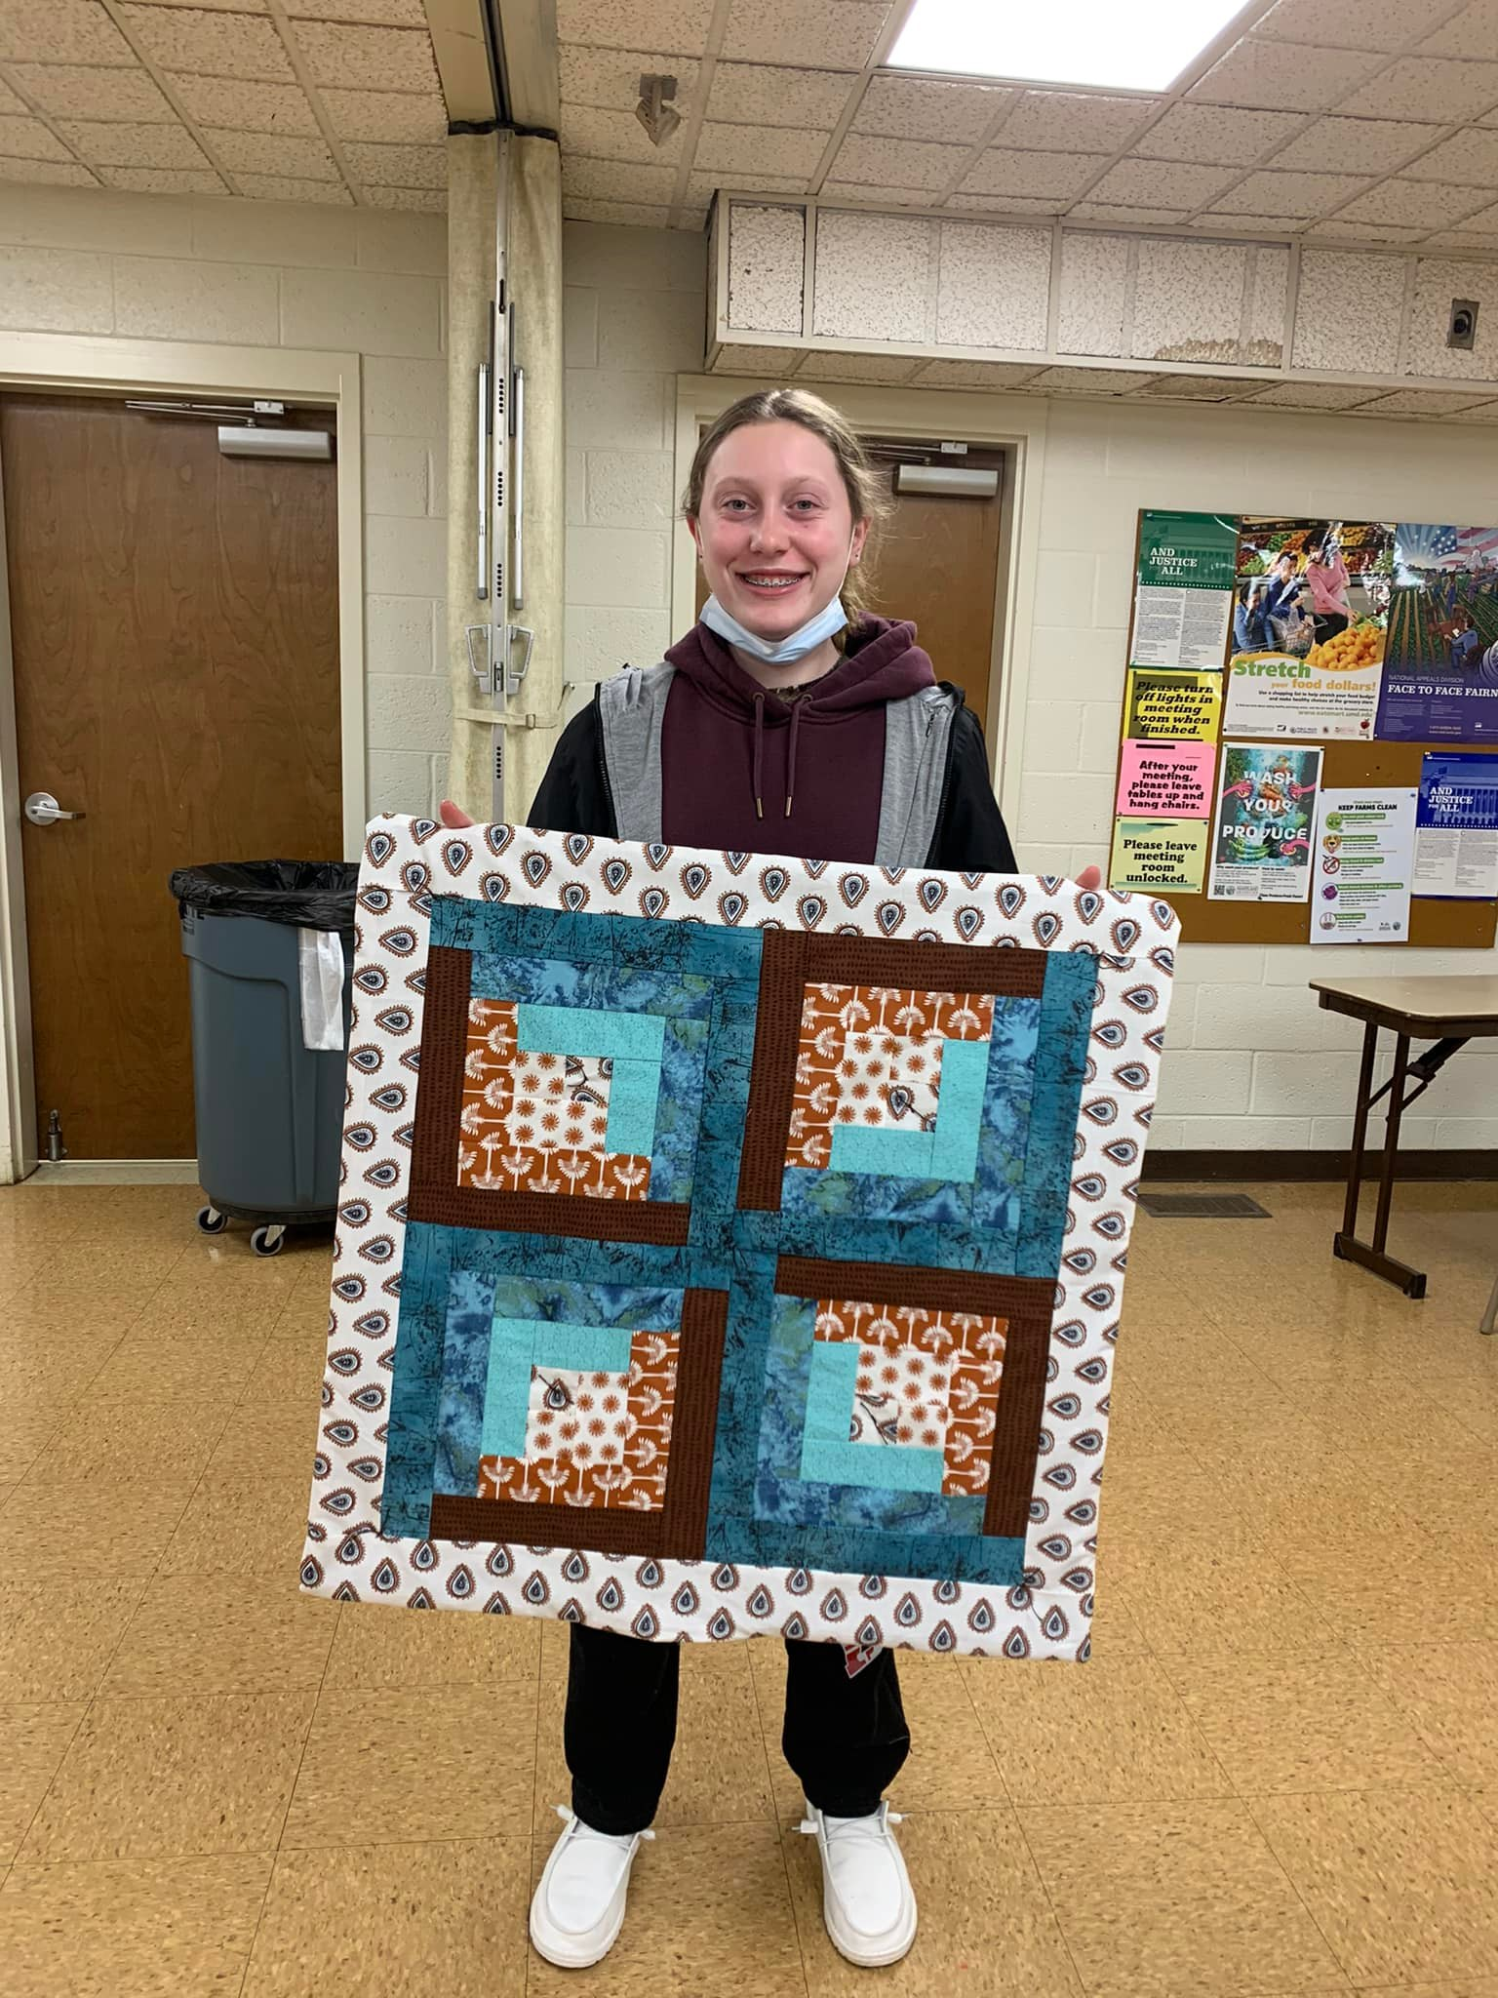
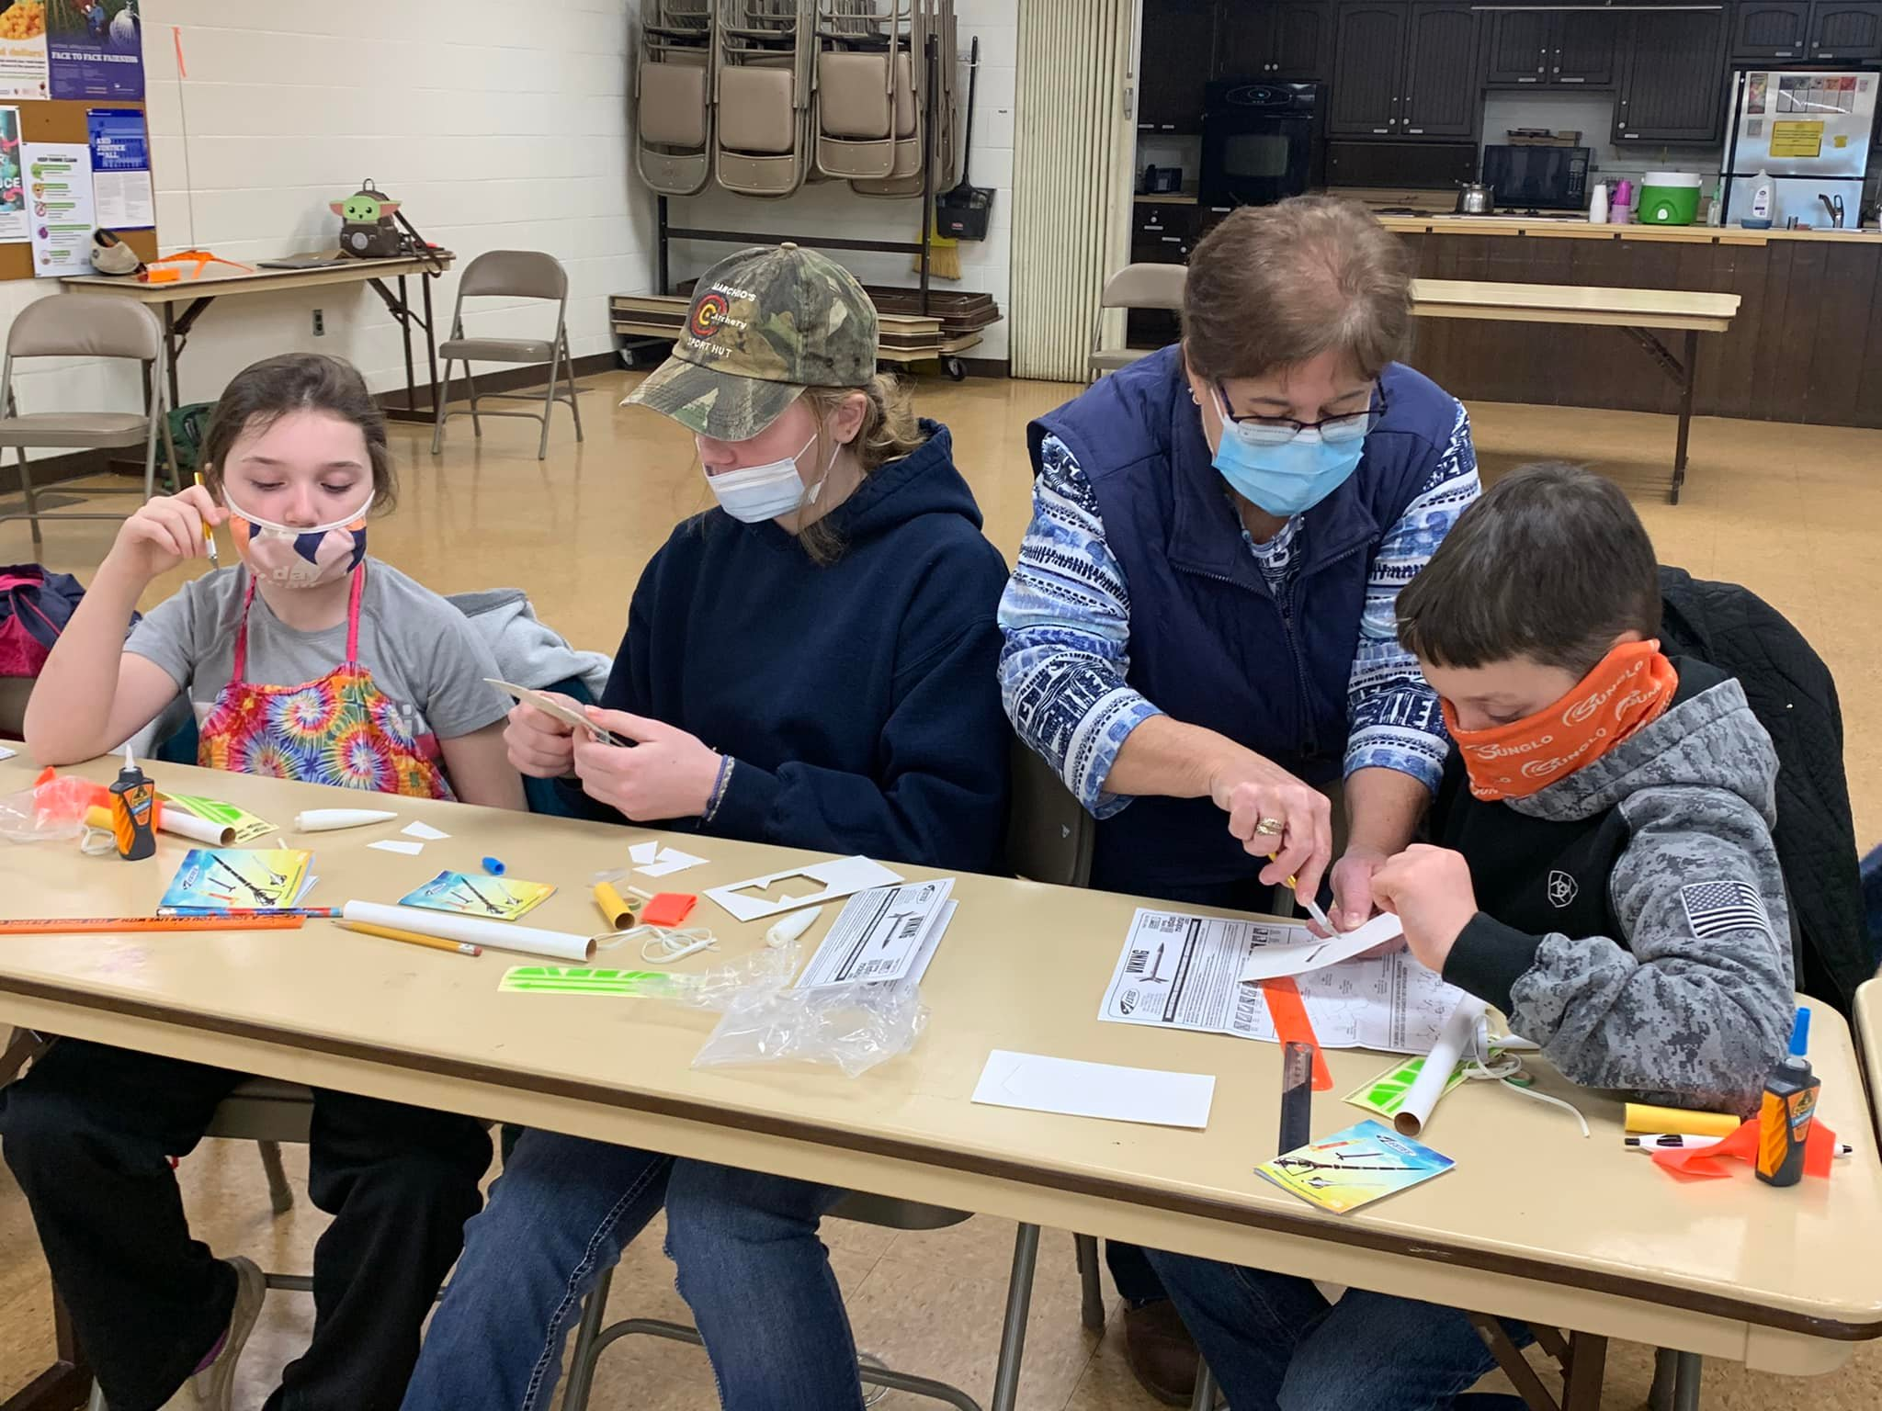
Many new workshops and project workshops were held throughout the year.

Slide 10
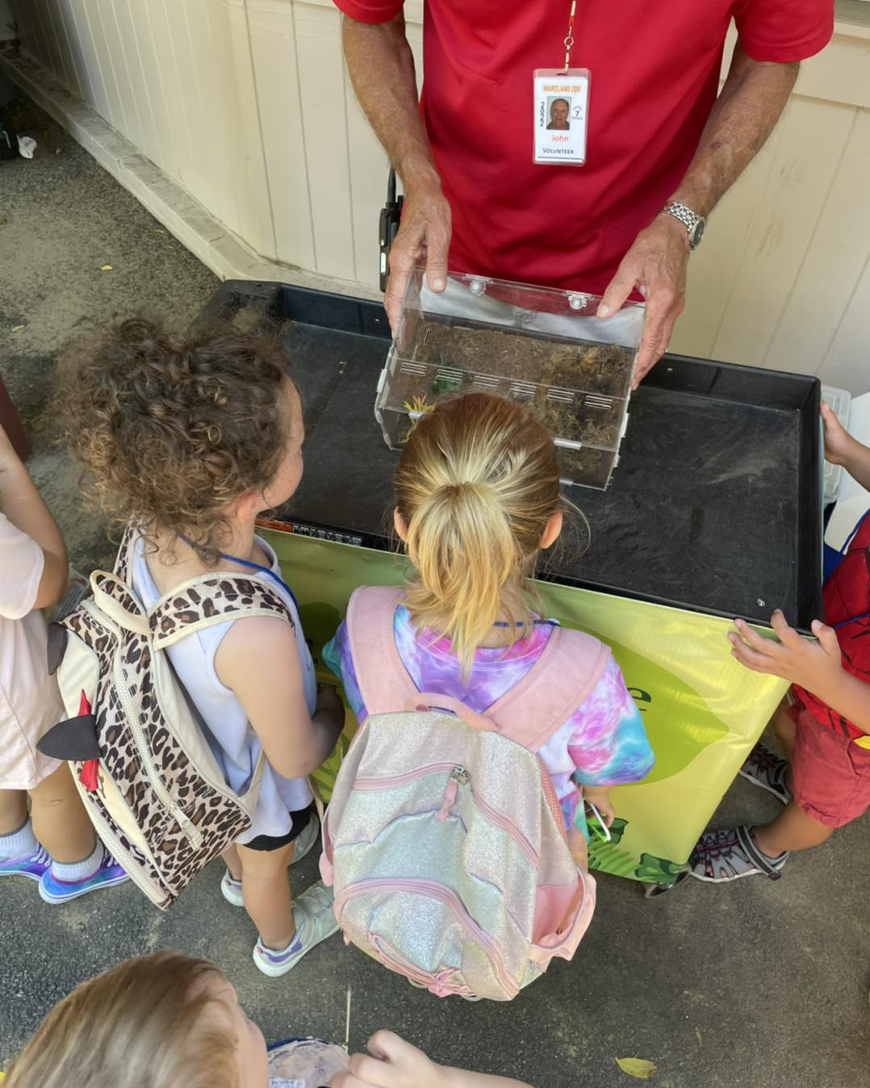
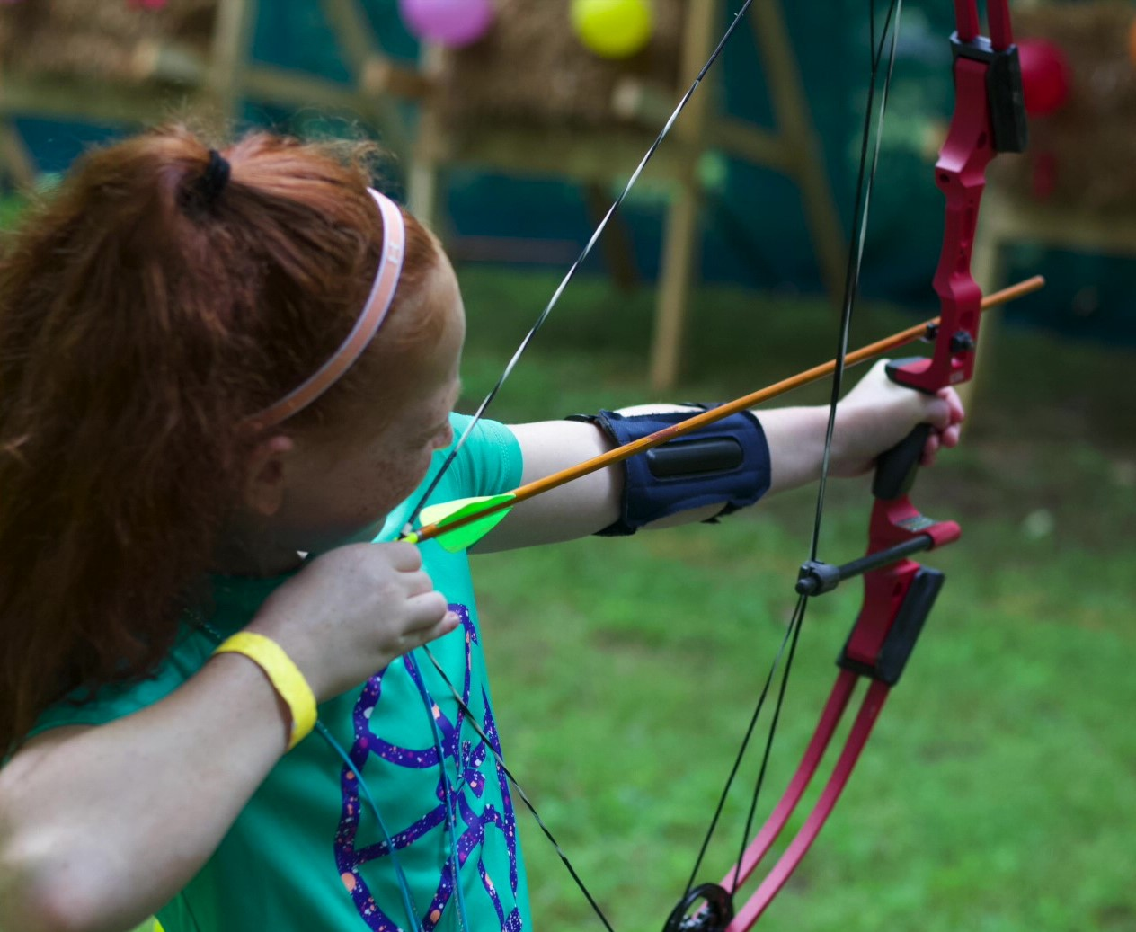
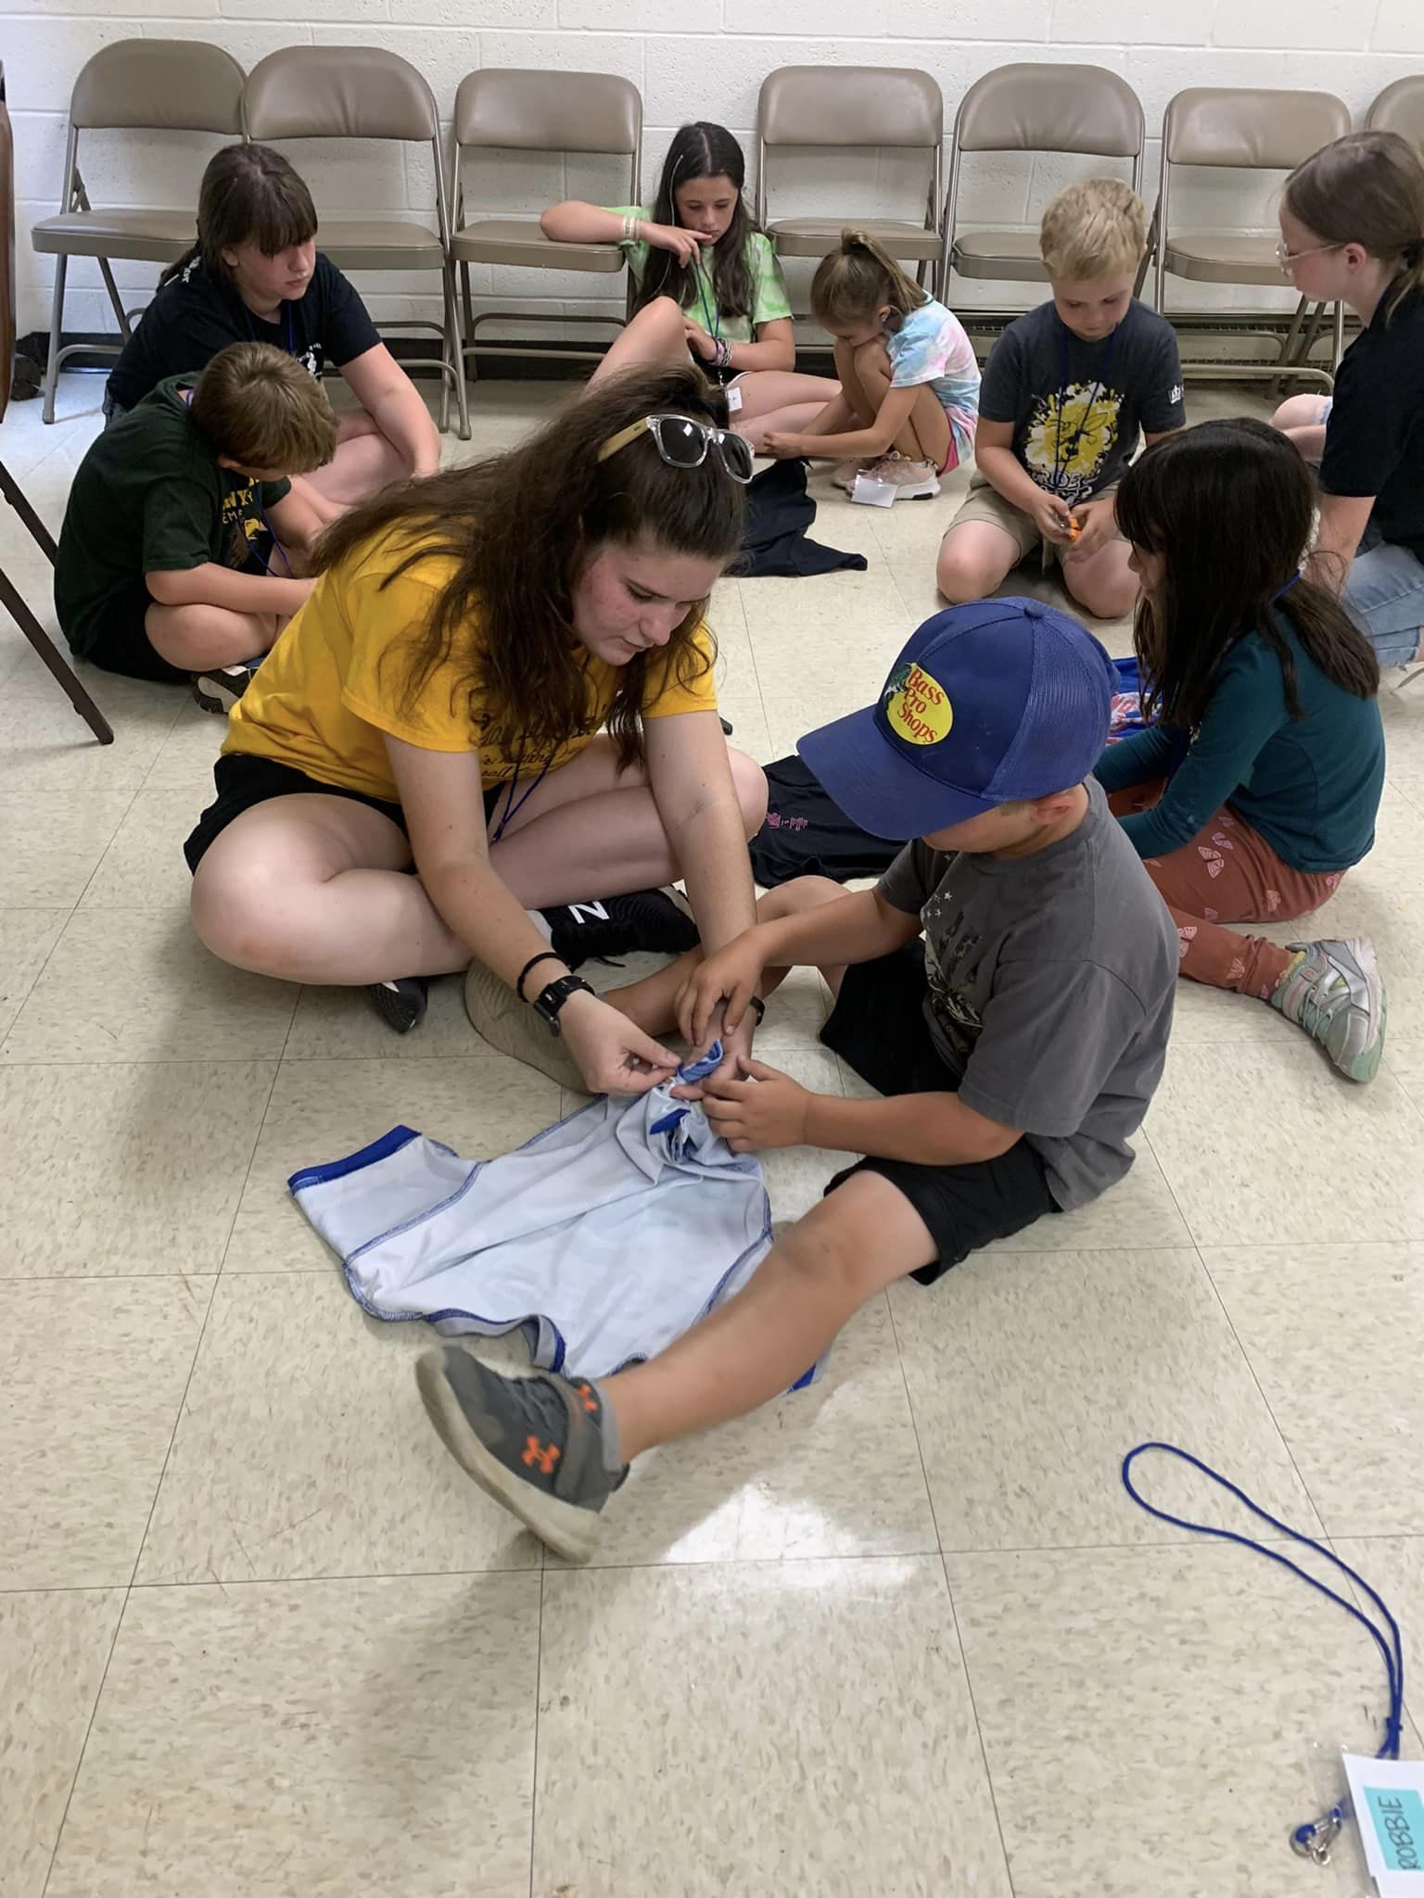
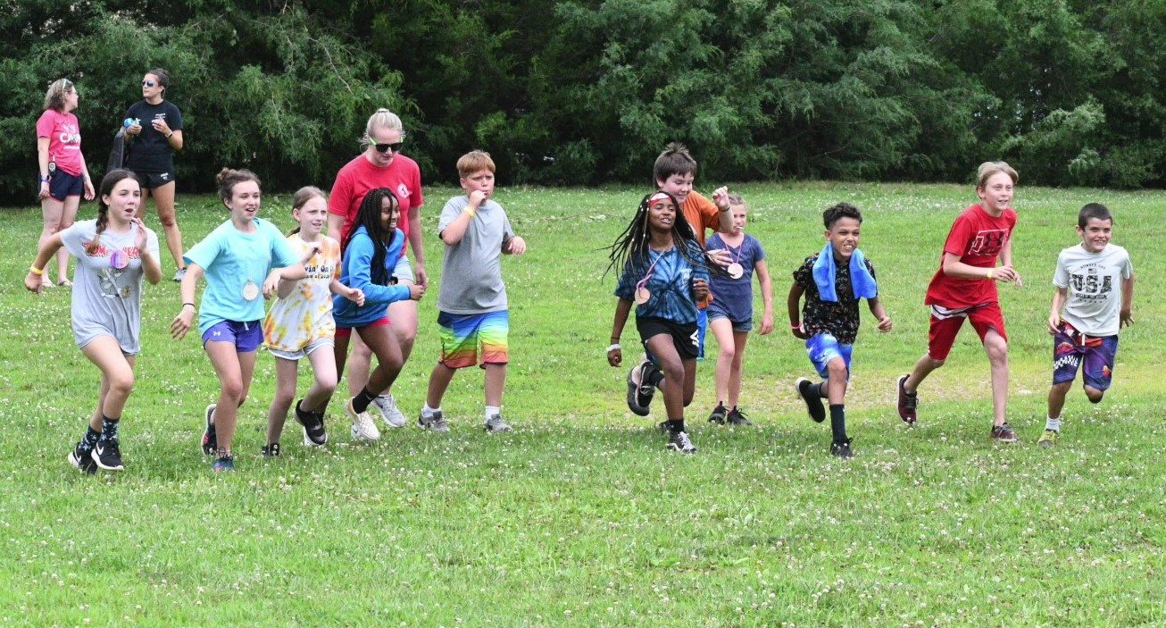
Over 30 youth attended Clover Days, 25 at Shooting Sports camp and 205 youth attended residential camp

Slide 11
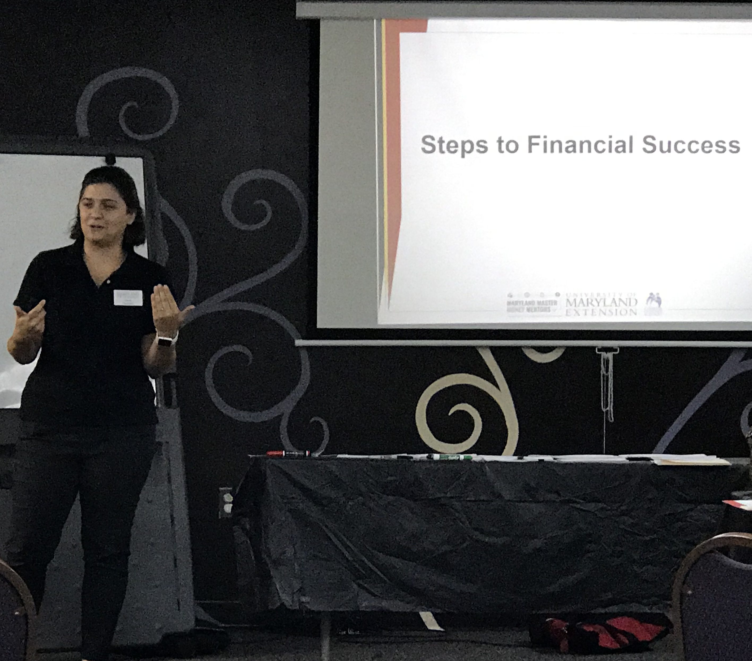
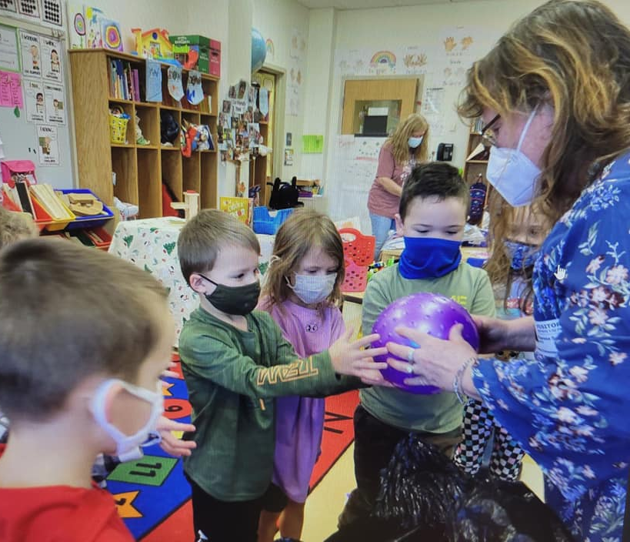
Family and Consumer Science educators reached 6,671 people with programs to help improve their health and finances

Slide 12


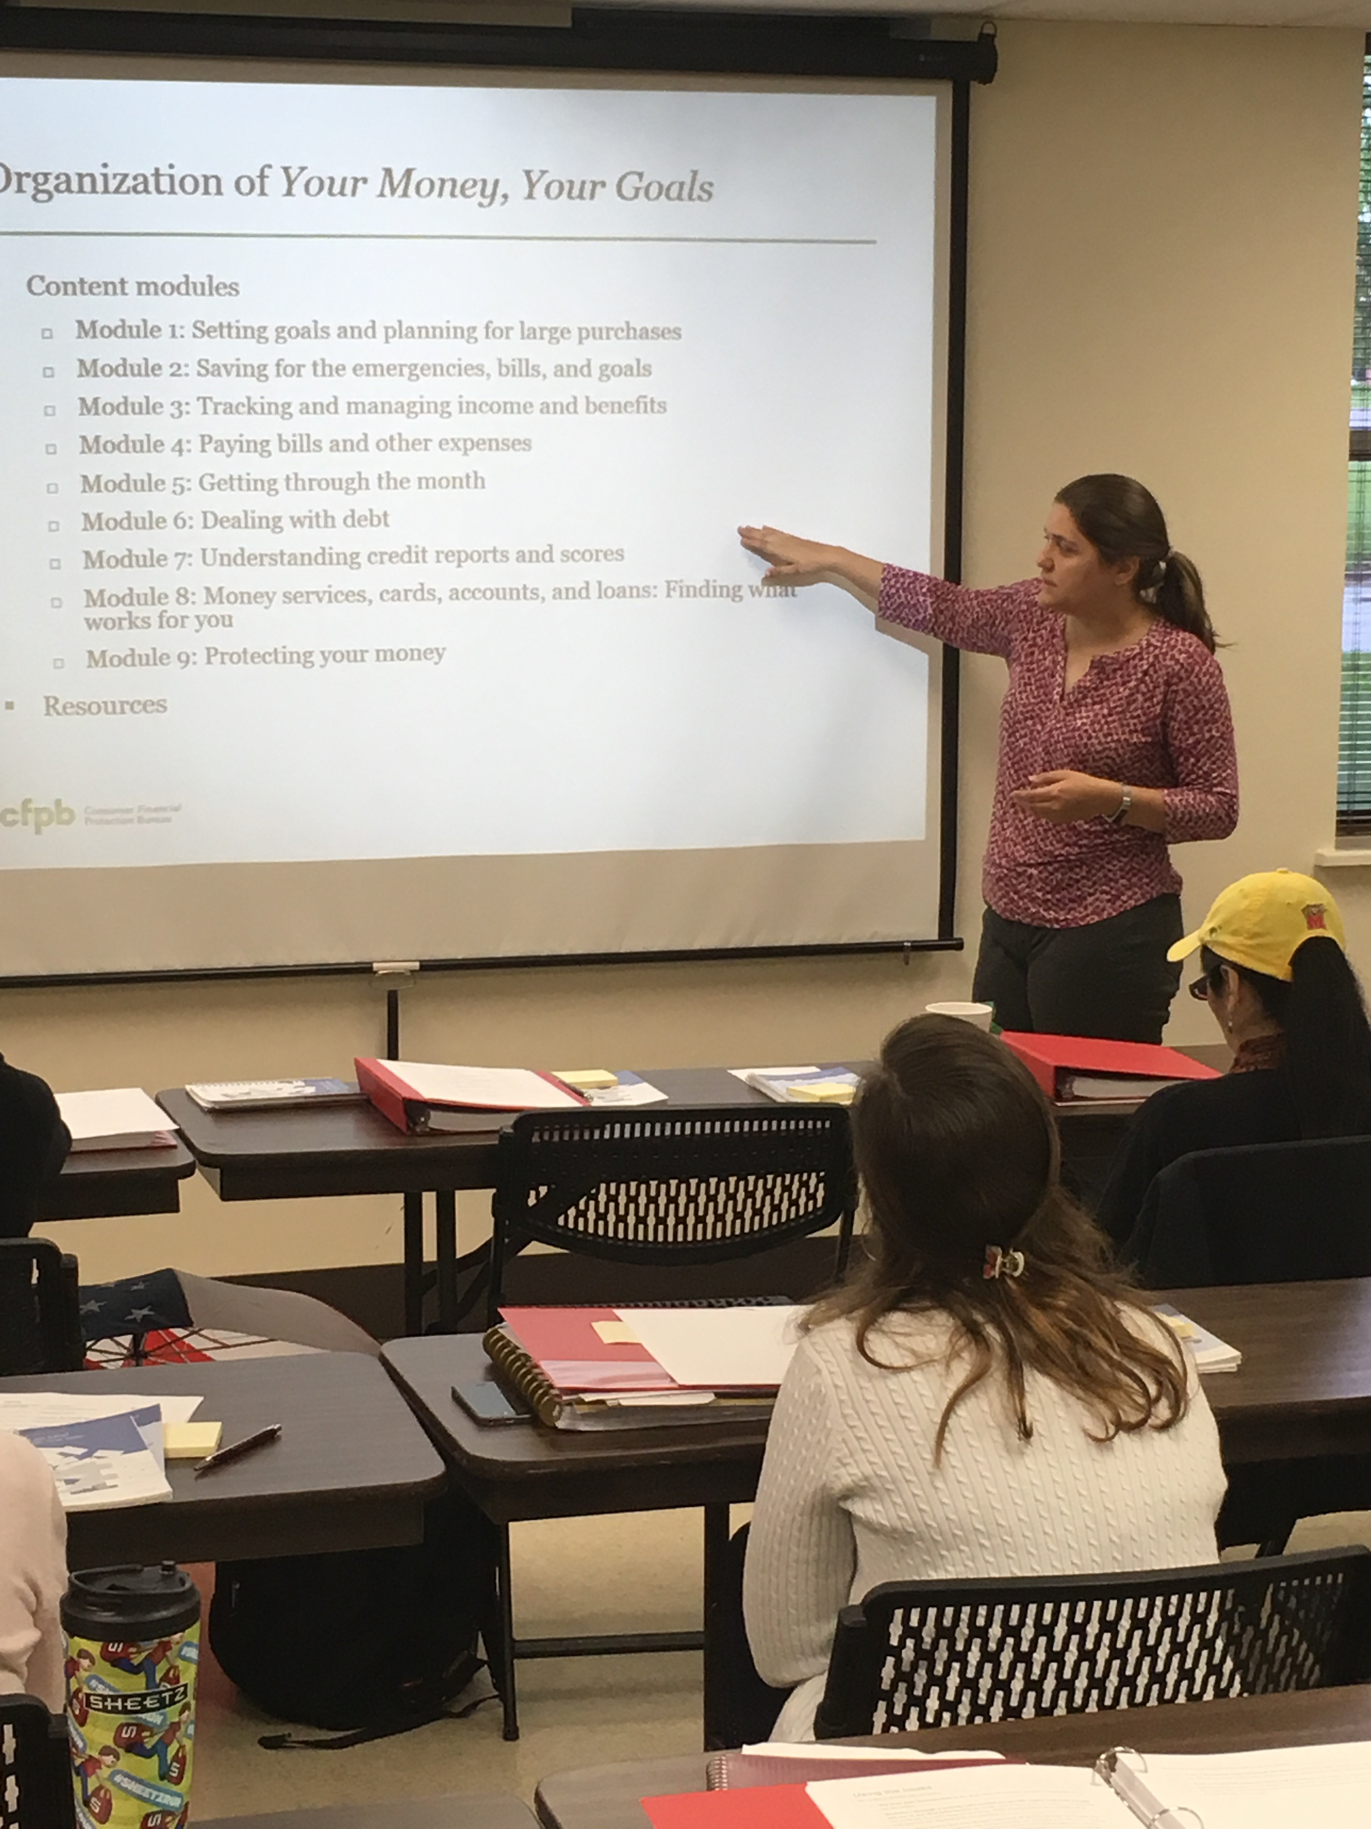


New & innovative financial education covering student loans, health insurance, credit scores, and more!

Slide 13
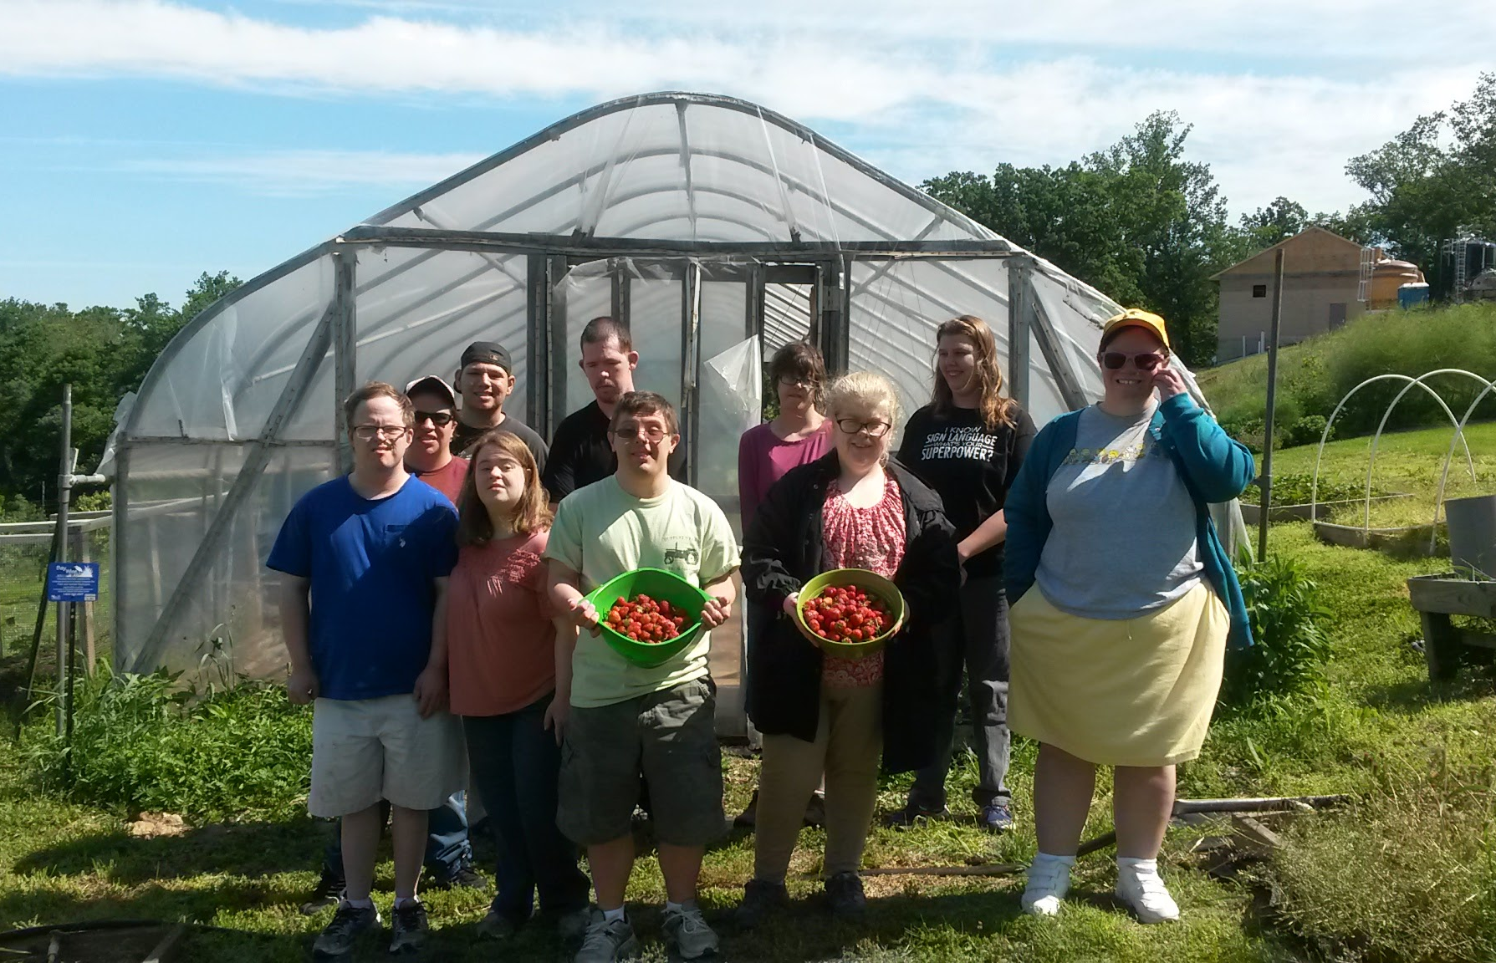
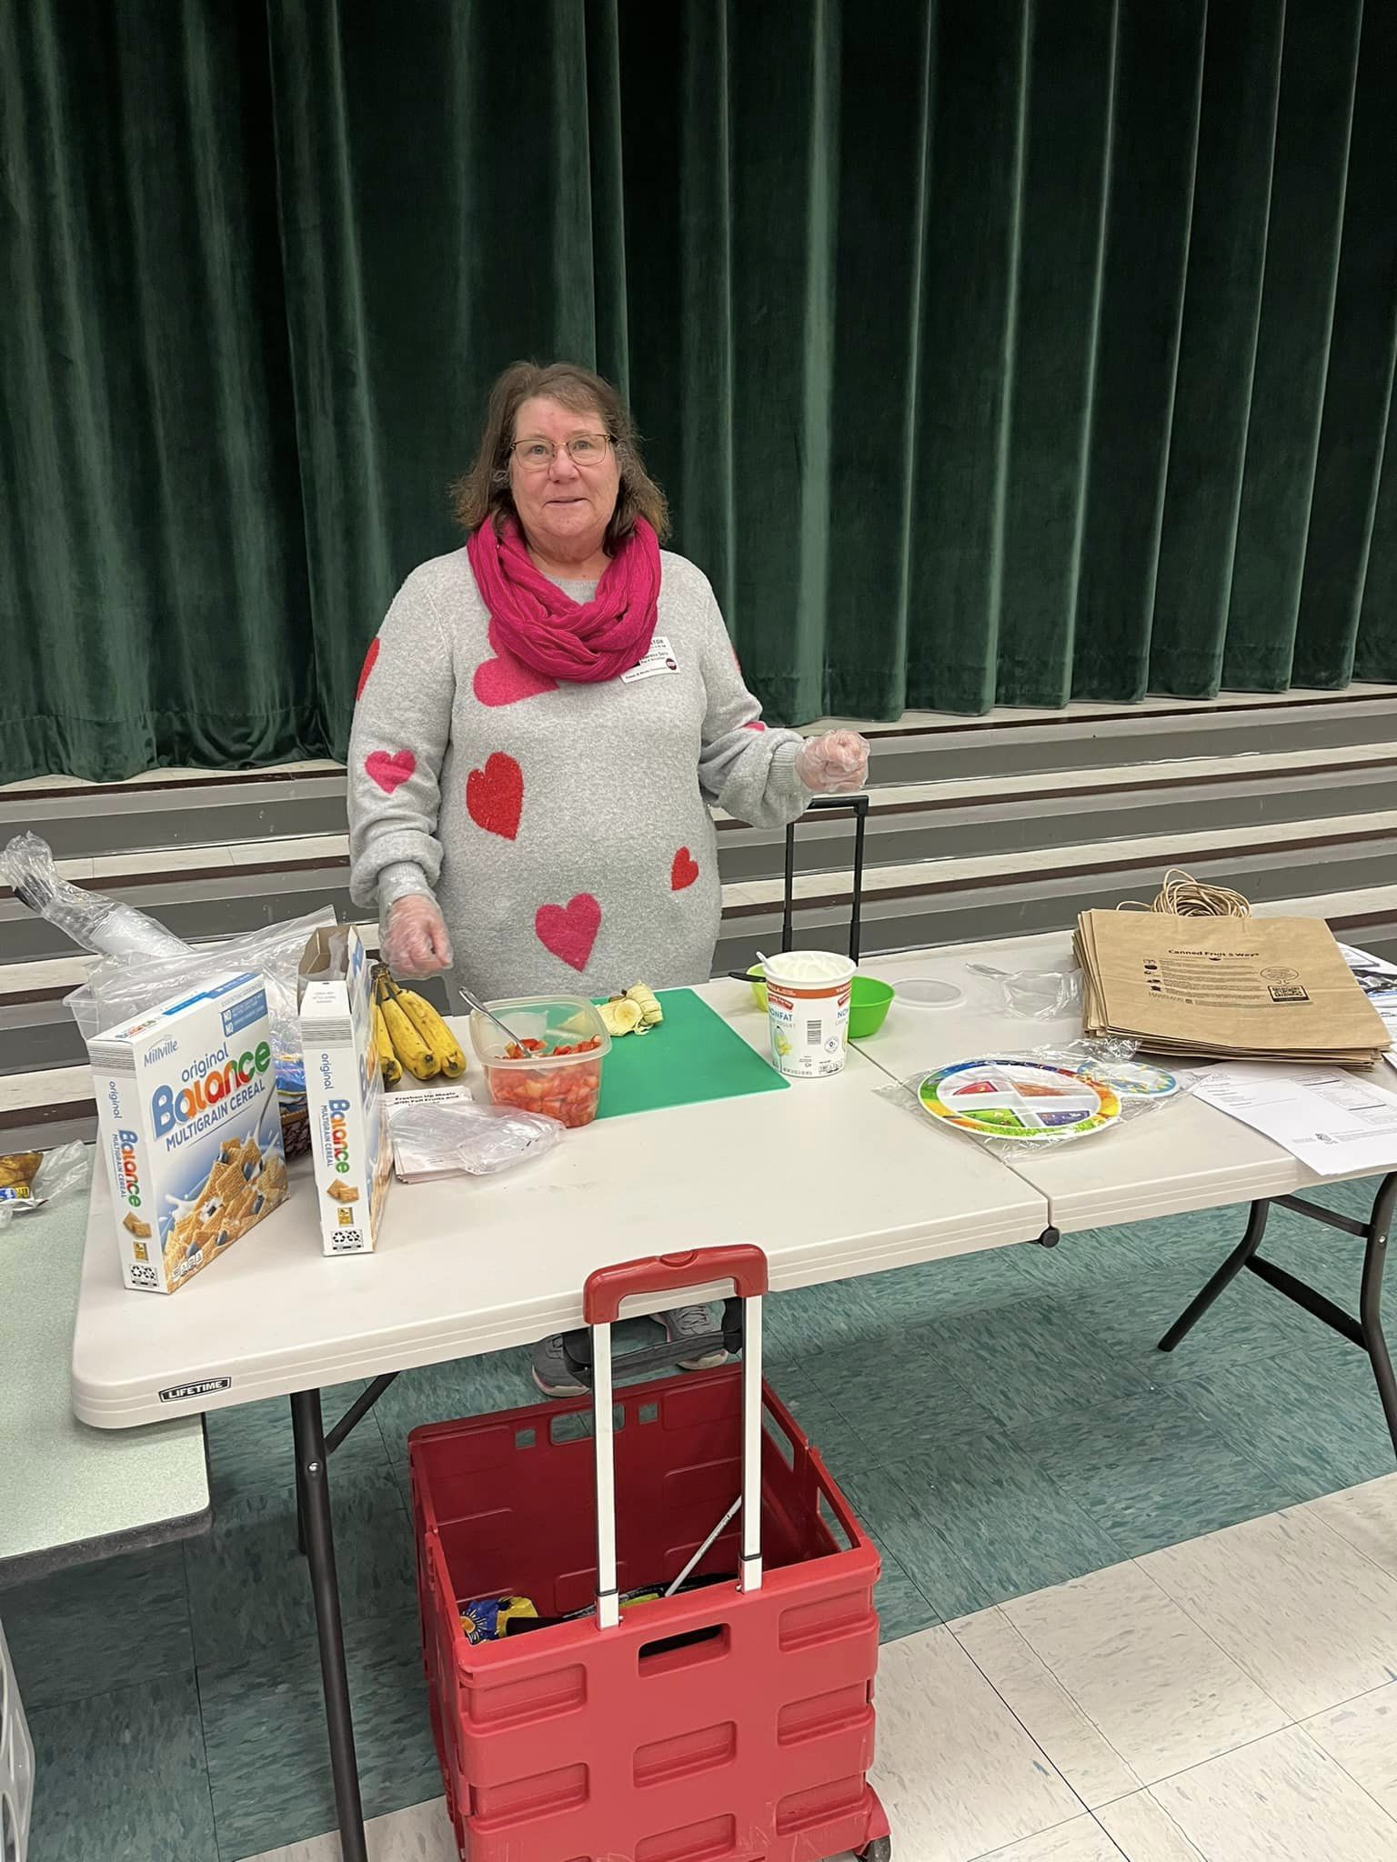
Fun and engaging nutrition and physical activity programs for all!

Slide 14




School Health Council
Early Childhood Advisory Council
The FCS & Snap-Ed Educators serve on several community committees benefitting the health of Carroll residents

Slide 15
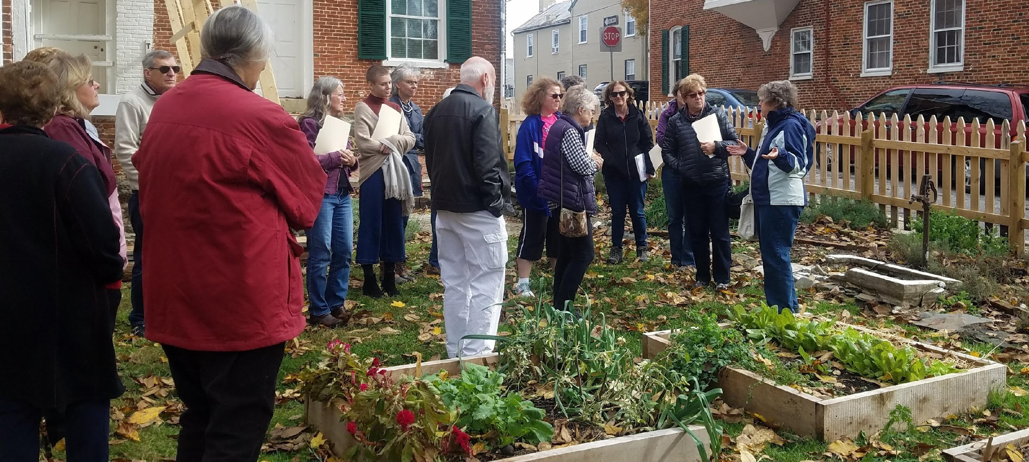
82 Master Gardeners volunteered 3,864 hours valued at $115,727 to educate residents and improve landscapes

Slide 16
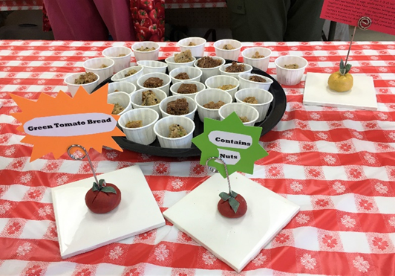
The Heirloom Tomato Festival hosted over 750 visitors learning about tomatoes and food gardening

Slide 17
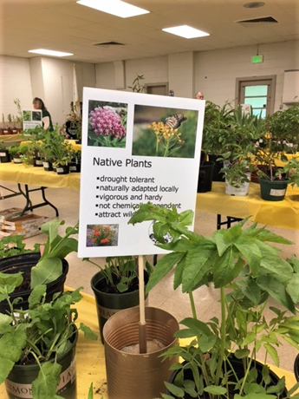
Using Native Plants in home landscaping is encouraged to reduce pesticides and increase pollinator food sources.

Slide 18
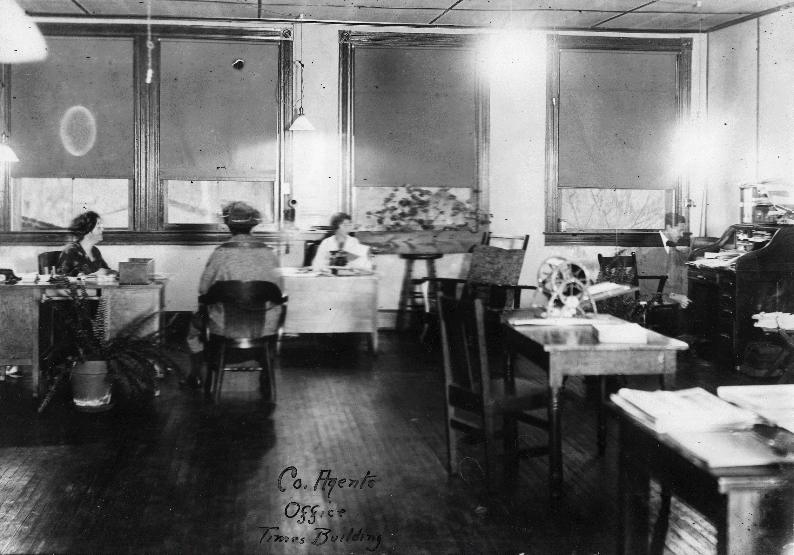
We’ve come a long way… and we are still here and proud to serve Carroll County
This institution is an equal opportunity provider.

