Slide 1


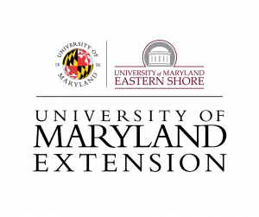
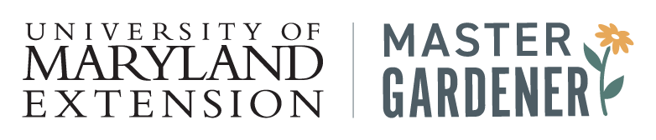
Notes:
ORGANIZATIONAL FLOW CHART
This flow chart represents how the UME Master Gardener program fits into the larger University of Maryland system.
The University of Maryland is the state’s flagship land-grant institution. It has 13 different Colleges and Schools. One college is the College of Agriculture and Natural Resources.
The College of Agriculture and Natural Resources (AGNR) has three parts: Academics, Research, and Extension. Campus faculty in the College of AGNR spend their time teaching college students (Academics) and conducting Research. University of Maryland Extension field faculty (and some campus faculty) serve Maryland through outreach and education programs (Extension).
University of Maryland Extension has over thirty different outreach and educational programs spanning across Maryland.
In order to reach more people in their communities, faculty often teach volunteers, who can then share their new knowledge locally. One volunteer education program where this happens is the UME Master Gardener program. This program is supported by University of Maryland Extension and its mission is to educate Maryland residents about safe, effective, and sustainable horticultural practices.

Slide 2





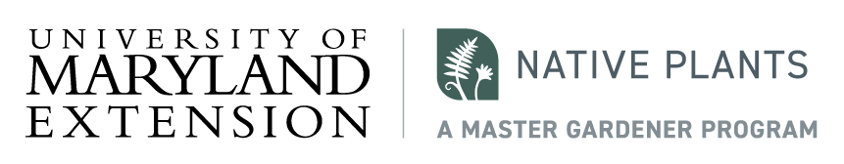
Notes:
UME Master Gardener volunteers are typically involved in projects focusing on one of six main topic areas. Additional focus areas (e.g., Therapeutic Horticulture) do exist.
Ask a Master Gardener Plant Clinic: Outreach education about plant and pest problems. Residents get their questions answered at plant clinics typically held at libraries and farmers markets.
Grow It Eat It: Teaching and promoting backyard and community food production. This also includes demonstration gardens, Grow It Eat It Preserve It, and produce donations to food banks.
Bay-Wise: Better water and soil quality through smarter gardening.
Pollinators: Education around integrated pest management (IPM), pollinators, and natural enemies.
Composting: Also known as "Urban Nutrient Management" which includes education about backyard/community composting, soil testing and improvement, and fertilizer use.
Native Plants: Education and project work around native plants and invasive plants.

